Slide 1
Operations Update
February 15, 2022
Notes:
Good Evening Dr. Little, Madam Chair, Members of the board I am excited to be here tonight to provide the February operations update. Facility improvements continue to occur here in Lexington 1 through the 2018 Bond Referendum and Capital Funding
and I look forward to showing you where we are with multiple projects.

Slide 2
Capital Project Update
Notes:
Before we get into the Bond Referendum projects I would like to provide a status update on other capital improvements ongoing in Lexington One. As you recall last August you were provided a list of projects including preventative maintenance items and other improvement opportunities identified by the Operations team. These projects are being funded through the 8% Bond Sale issued last October for facility improvement use. Preventative maintenance is critical in a system like Lexington One and we identify these projects through several metrics including life of system, performance of system, and feedback from school and maintenance personnel. The major preventative maintenance categories are roofing, mechanical, water heaters and asphalt and we are able to address some of these areas through this funding.

Slide 3
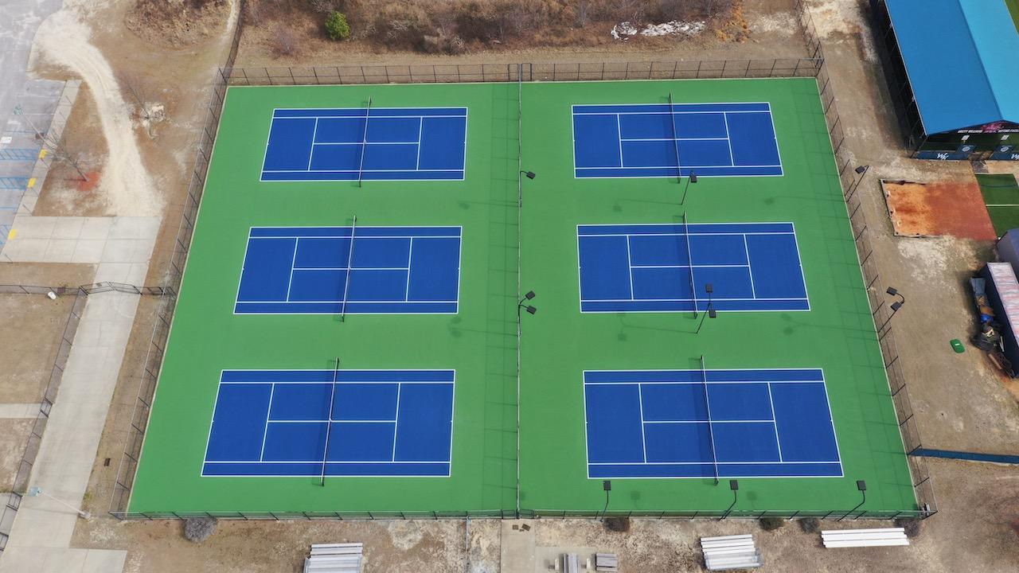
WKHS Tennis Court Resurfacing
Notes:
One of our priorities with this funding was to address most of the competition tennis courts throughout the district. You see here WKHS is complete and ready for practice and games. This is a very popular tennis court design as it mirrors what you see at the US Open courts.

Slide 4
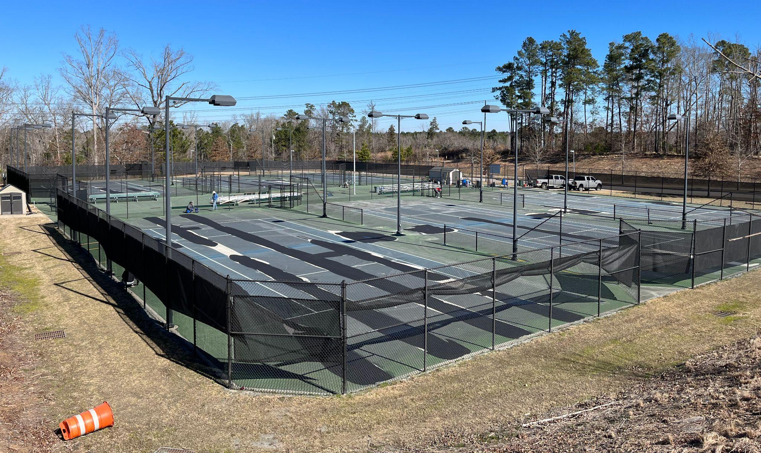
RBHS Tennis Court Resurfacing
Notes:
This same work is currently taking place at RBHS and the courts will soon mirror the look at White Knoll. These courts should be completed this week.

Slide 5
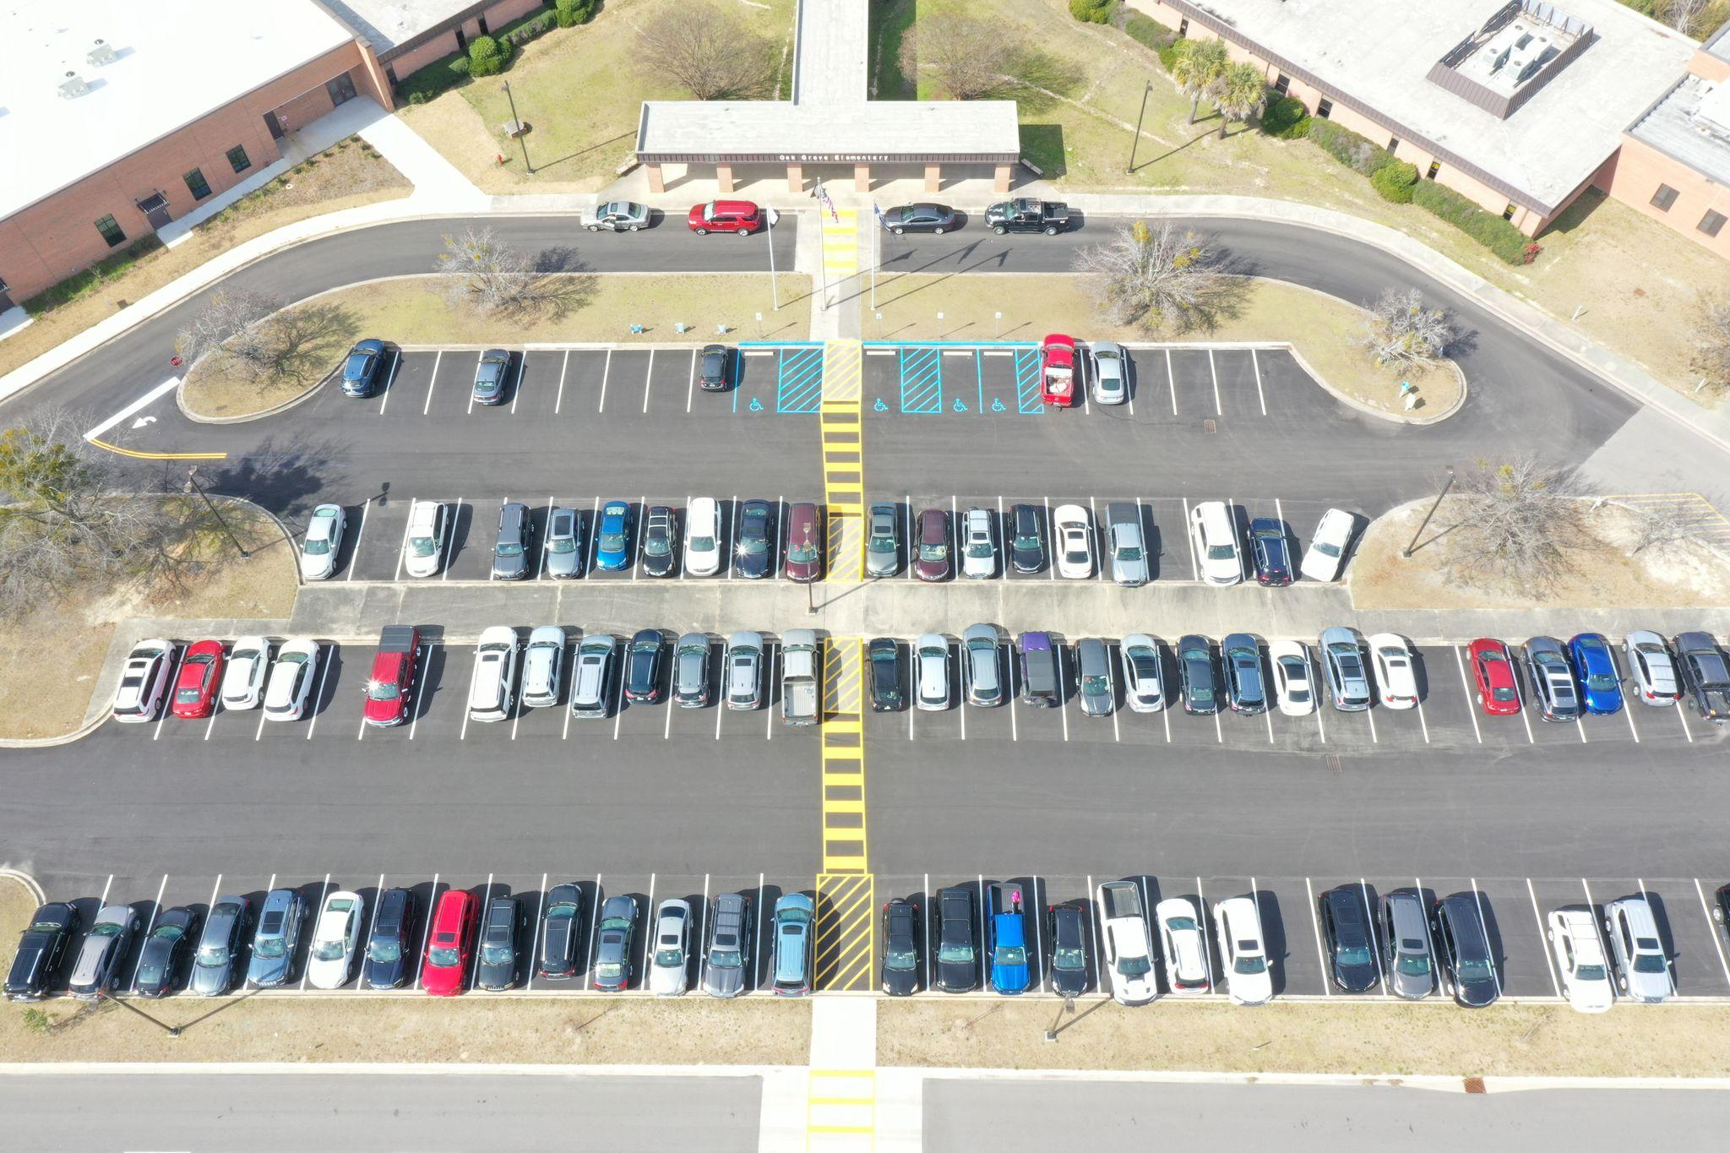
OGES Parking Lot Resurfacing
Notes:
At Oak Grove we resurfaced the visitor parking to match the additional parking lot completed during the referendum work. You see here an aerial view of this completed project

Slide 6
Upcoming Projects
Gilbert Middle HVAC (Summer 2022)
Lake Murray Roofing/HVAC (Summer 2022)
Gilbert High and Pelion High tennis court resurfacing (Spring 2022)
Gilbert High and Pelion High cafeteria furniture replacement (Spring 2022)
Lexington High and White Knoll High gym bleacher repair (Spring 2022)
Lexington Elementary exterior door and parking lot resurfacing (Spring 2022)
White Knoll Middle kitchen water heater replacement (Spring 2022)
Track paving (CSMS, MGMS, PHMS) - (Spring/Summer 2022)
Lexington Technology Center marquee sign replacement (Spring/Summer 2022)
Gilbert High competition track renovations (Summer/Fall 2022)
Notes:
Here is a list of upcoming Capital Projects to bring you up to speed on the work that will be occurring between now and the Fall.

Slide 7
Bond Referendum Project Update
Notes:
Now I would like to move into an update on our Bond Referendum Projects throughout the district

Slide 8
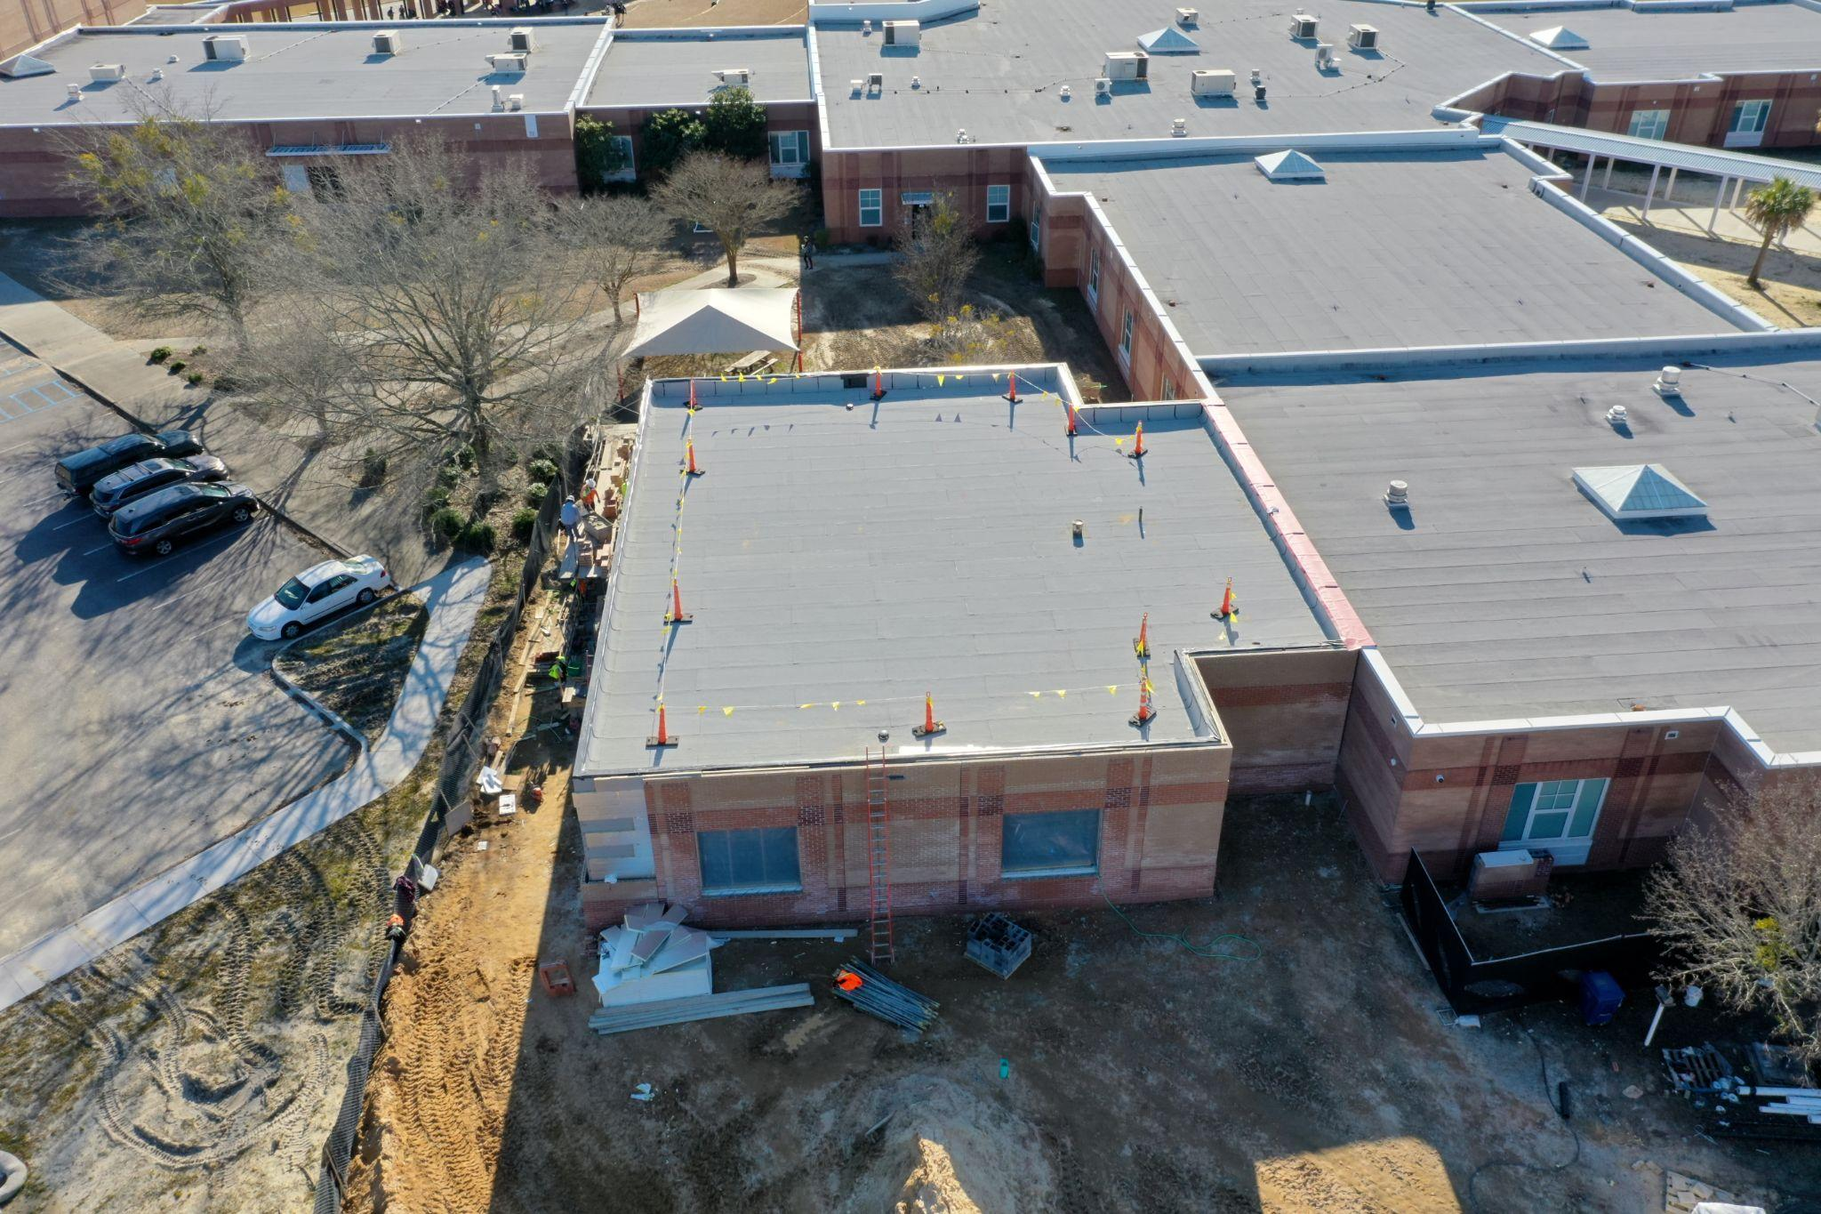
Gilbert Middle School
Notes:
The four classroom addition at Gilbert Middle School continues to track towards a Summer 2022 completion. You see the roof is complete and brickwork is nearing completion. Also as you can see we really strive to make any additions to our facilities look like they have always been there. That is very important to us and you can see that happening here with the addition.

Slide 9
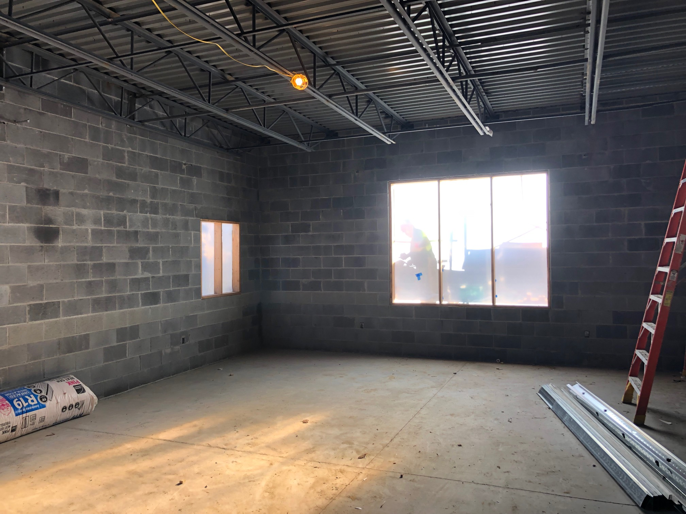
Gilbert Middle School
Notes:
Here is a photo of inside one of the classrooms.

Slide 10
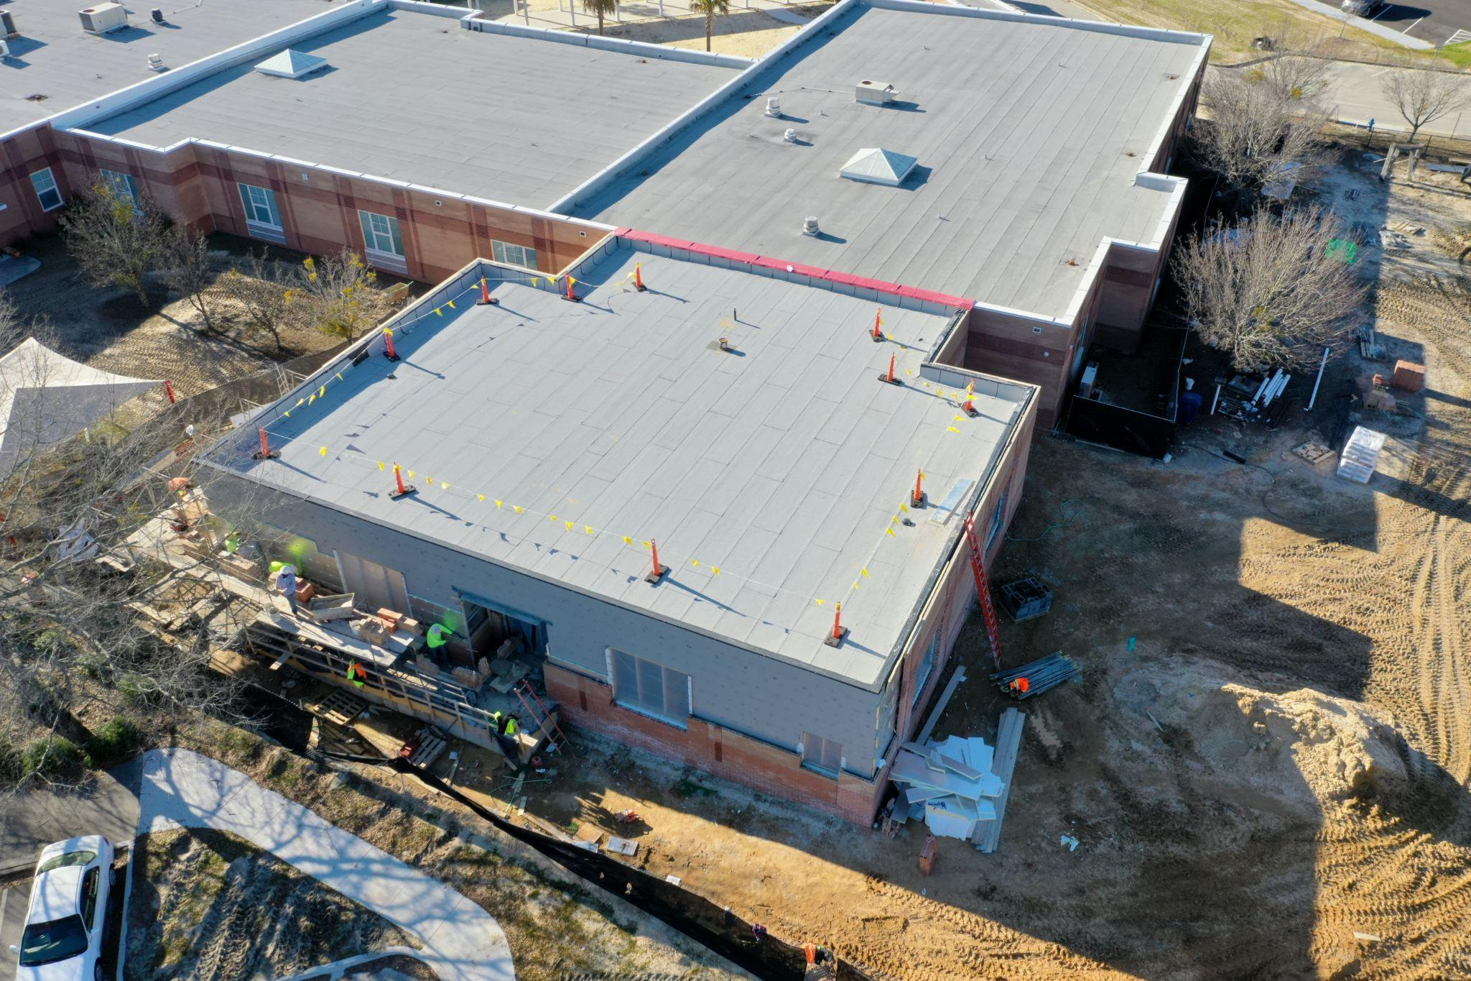
Gilbert Middle School
Notes:
Another aerial of the addition showing the remaining brickwork and windows that will soon be installed.

Slide 11
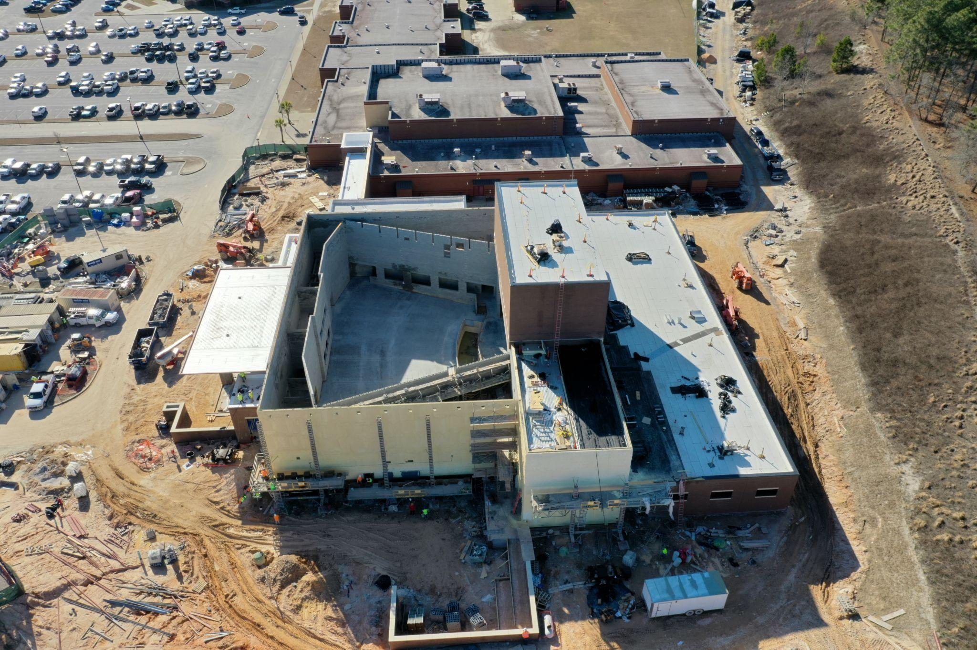
Gilbert High School
Notes:
Moving to Gilbert High School and the Performing Arts and athletic addition. Progress continues to occur in Gilbert and the work is tracking for a summer completion.

Slide 12
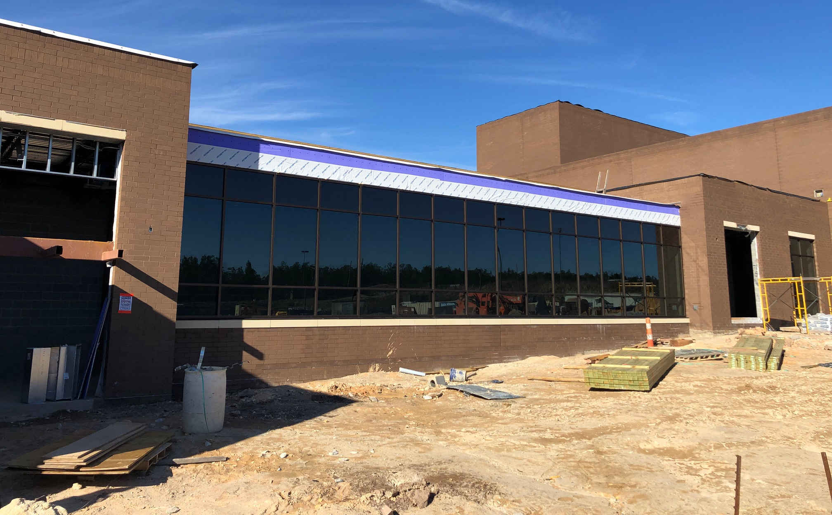
Gilbert High School
Notes:
I mentioned this space last month and you can see the progress that has occurred here in this photo. This is the connecting corridor between the existing school and the addition.

Slide 13
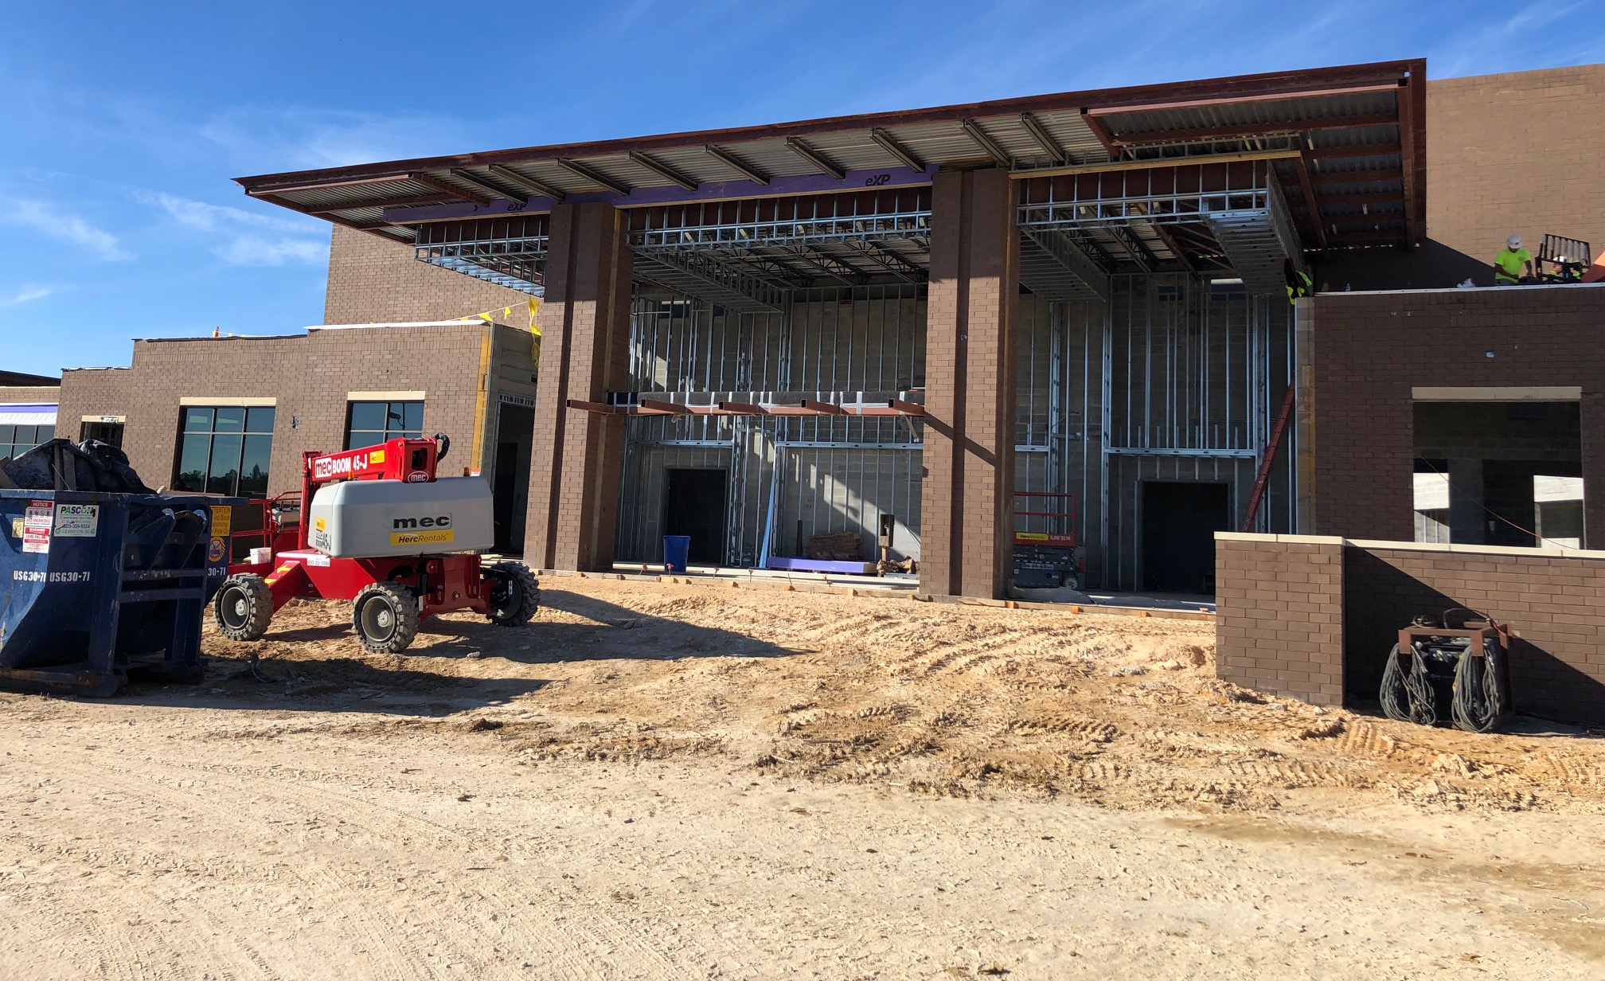
Gilbert High School
Notes:
Here you see the front of the Performing Arts Center and what will be the lobby area and entry into the theatre.

Slide 14
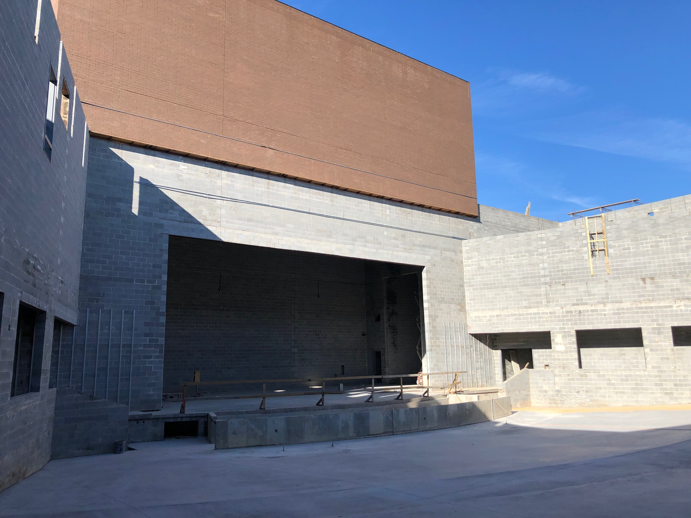
Gilbert High School
Notes:
This photo shows inside the theatre and fly loft area.

Slide 15
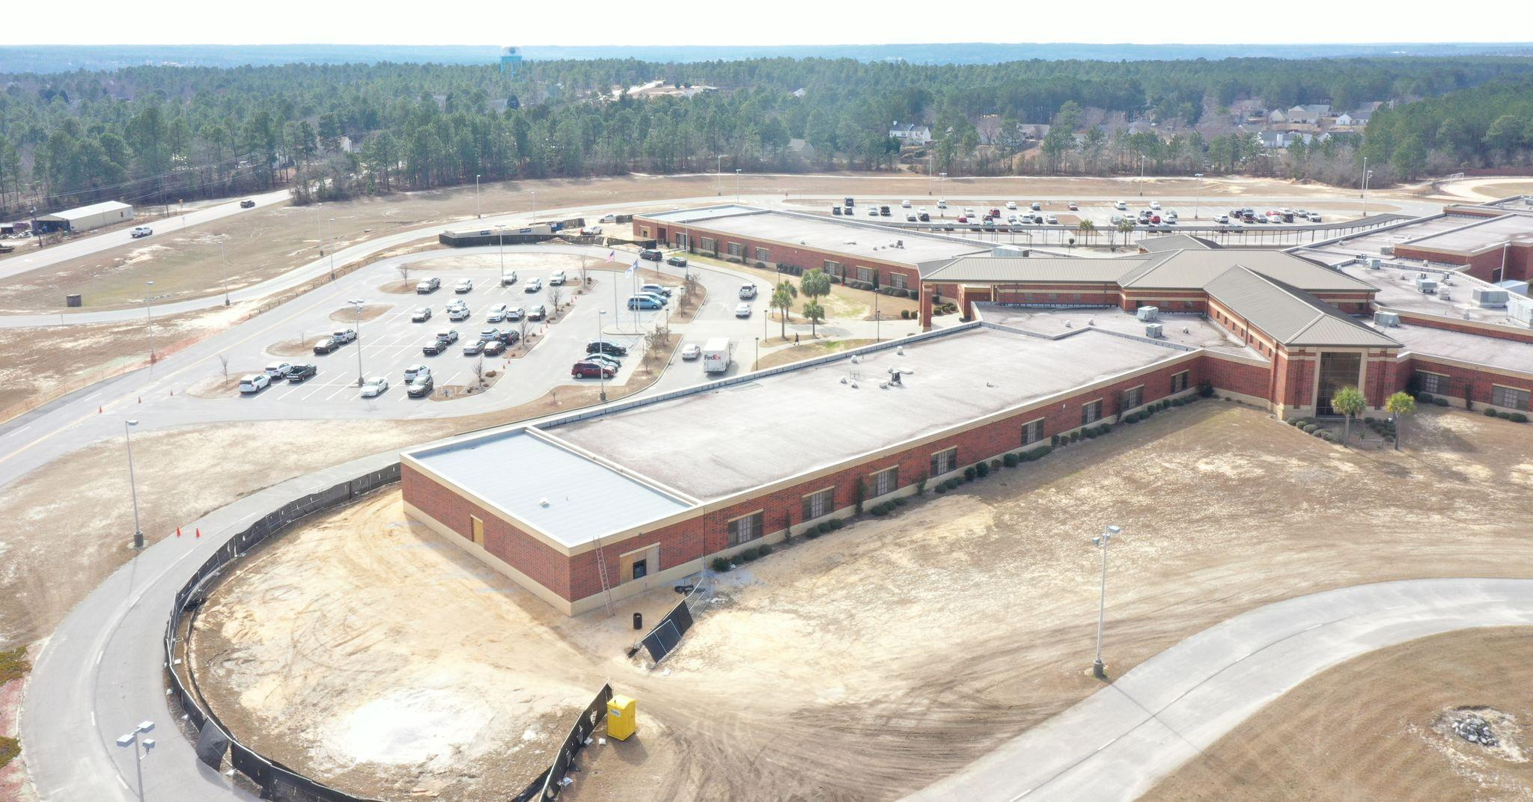
Carolina Springs Middle
Notes:
Moving to Carolina Springs Middle and the six classroom addition. This work is tracking for a late April/early May completion and we will be excited to turn these rooms over to Dr. Cockfield and his team.

Slide 16
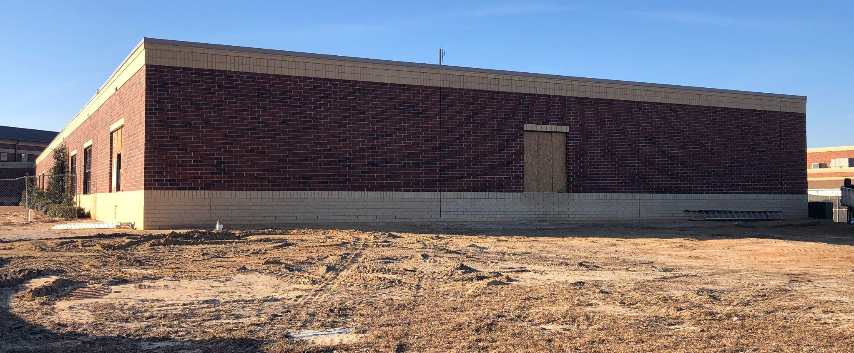
Carolina Springs Middle
Notes:
Photo of the exterior brick work and once again you can somewhat see the effort we put in to matching the addition to the existing facility.

Slide 17
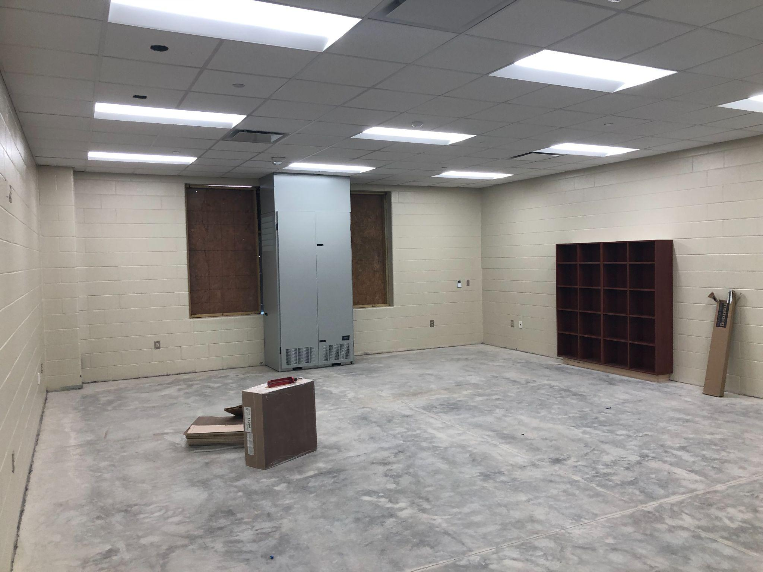
Carolina Springs Middle
Notes:
This is inside one of the 6 classrooms and just really waiting on flooring here and windows to complete this space.

Slide 18
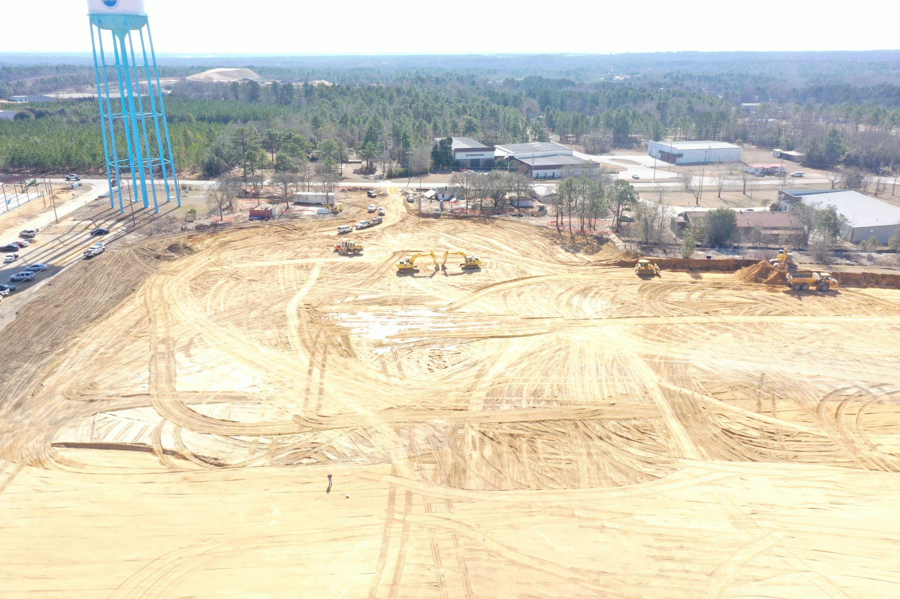
Transportation Facility

Slide 19
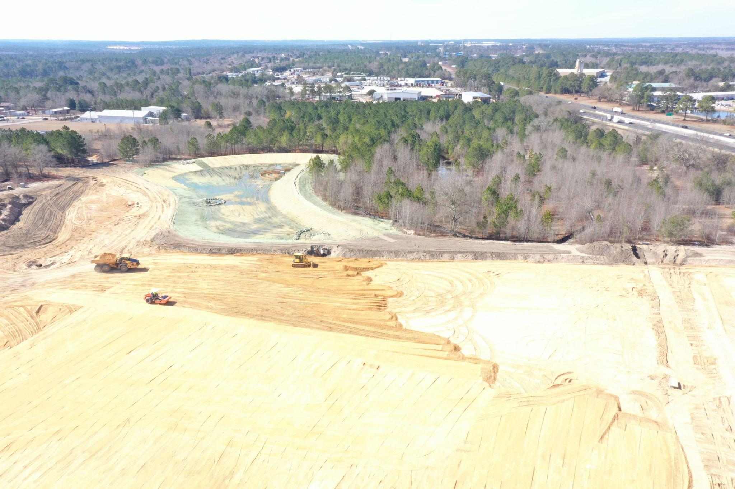
Transportation Facility

Slide 20
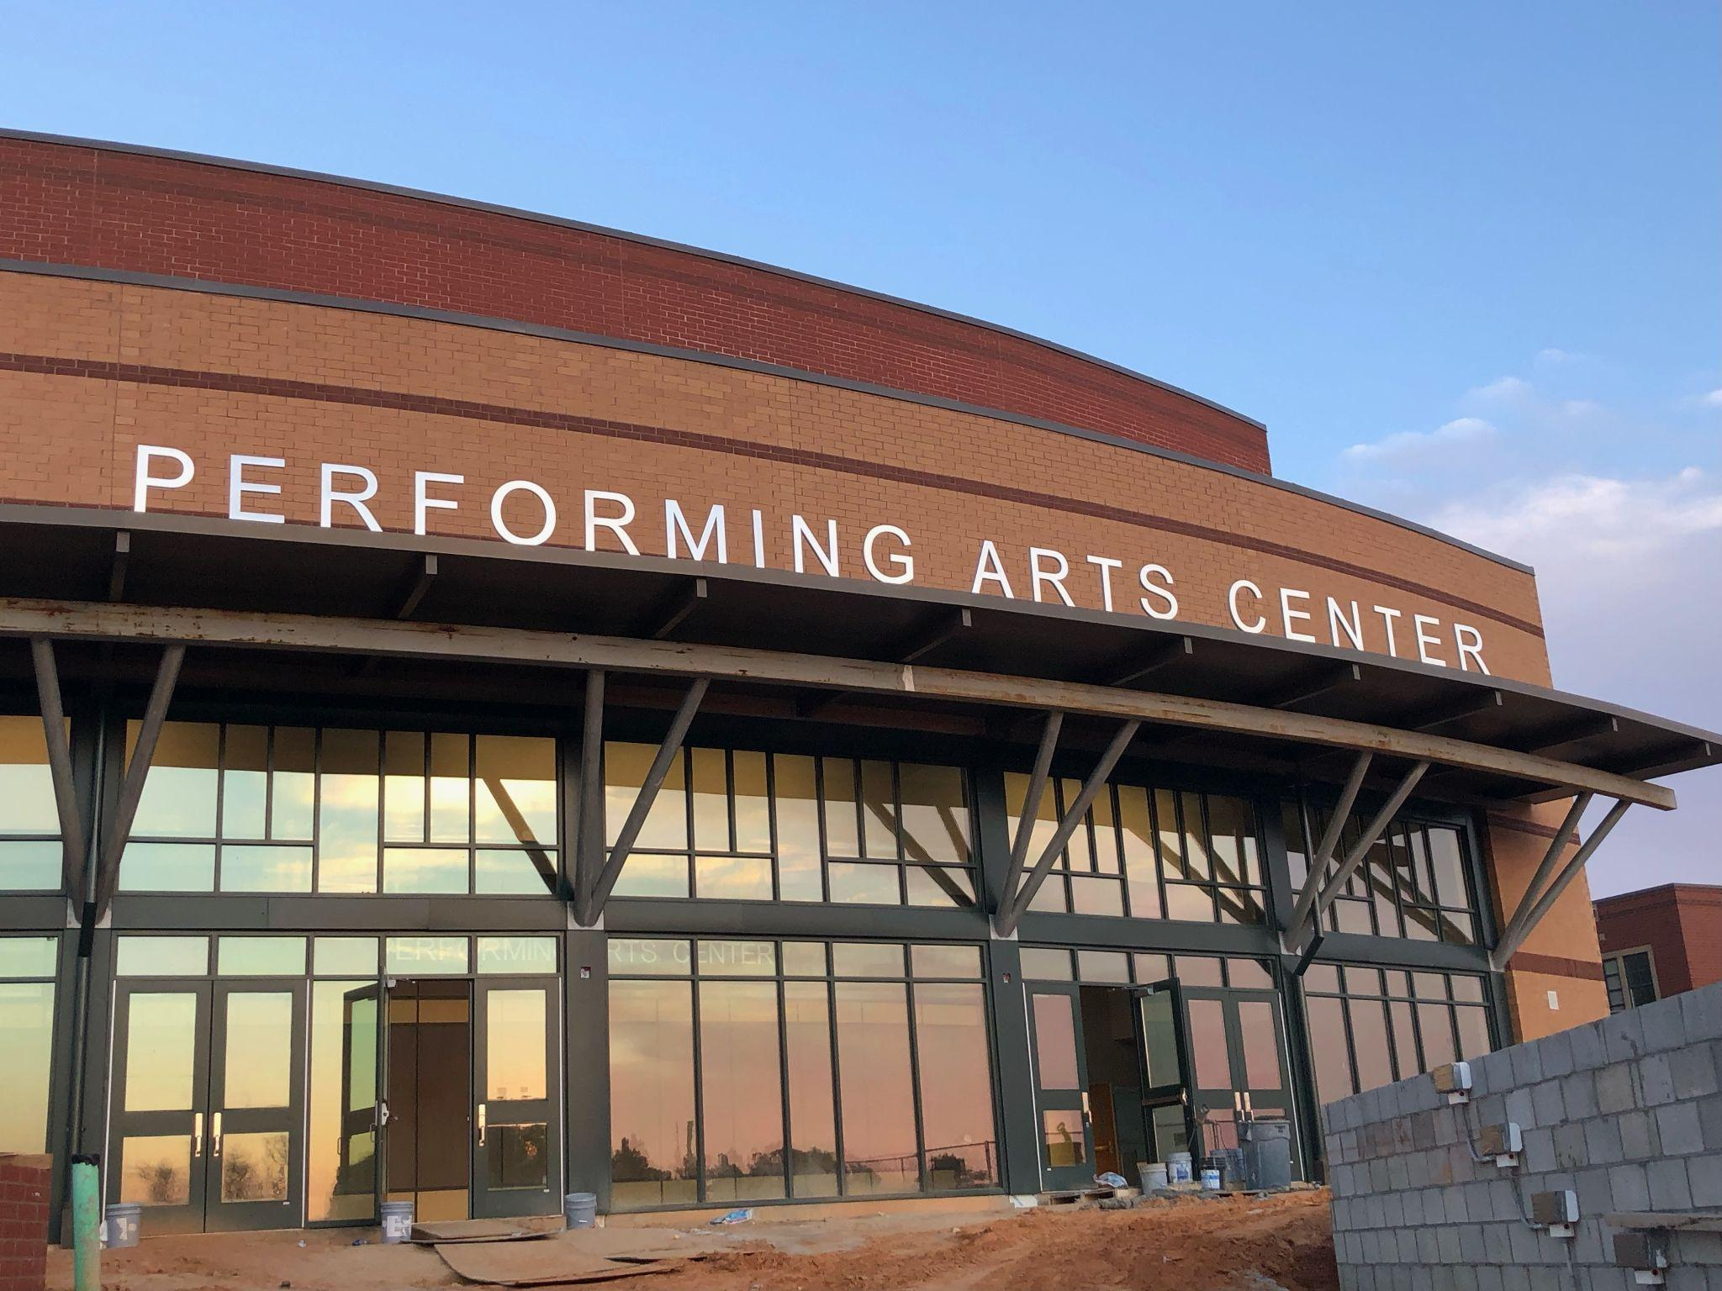
White Knoll High School
Notes:
On to White Knoll High School and probably my favorite photo from tonight’s presentation. This was actually sent to me Saturday night by one of our contractors who was on site doing some work and I just thought it was a phenomenal picture. The theatre will have a final inspection during the month of April and then will turned over to the school. Thrilled to see this facility in action and what it will bring to the White Knoll community.

Slide 21
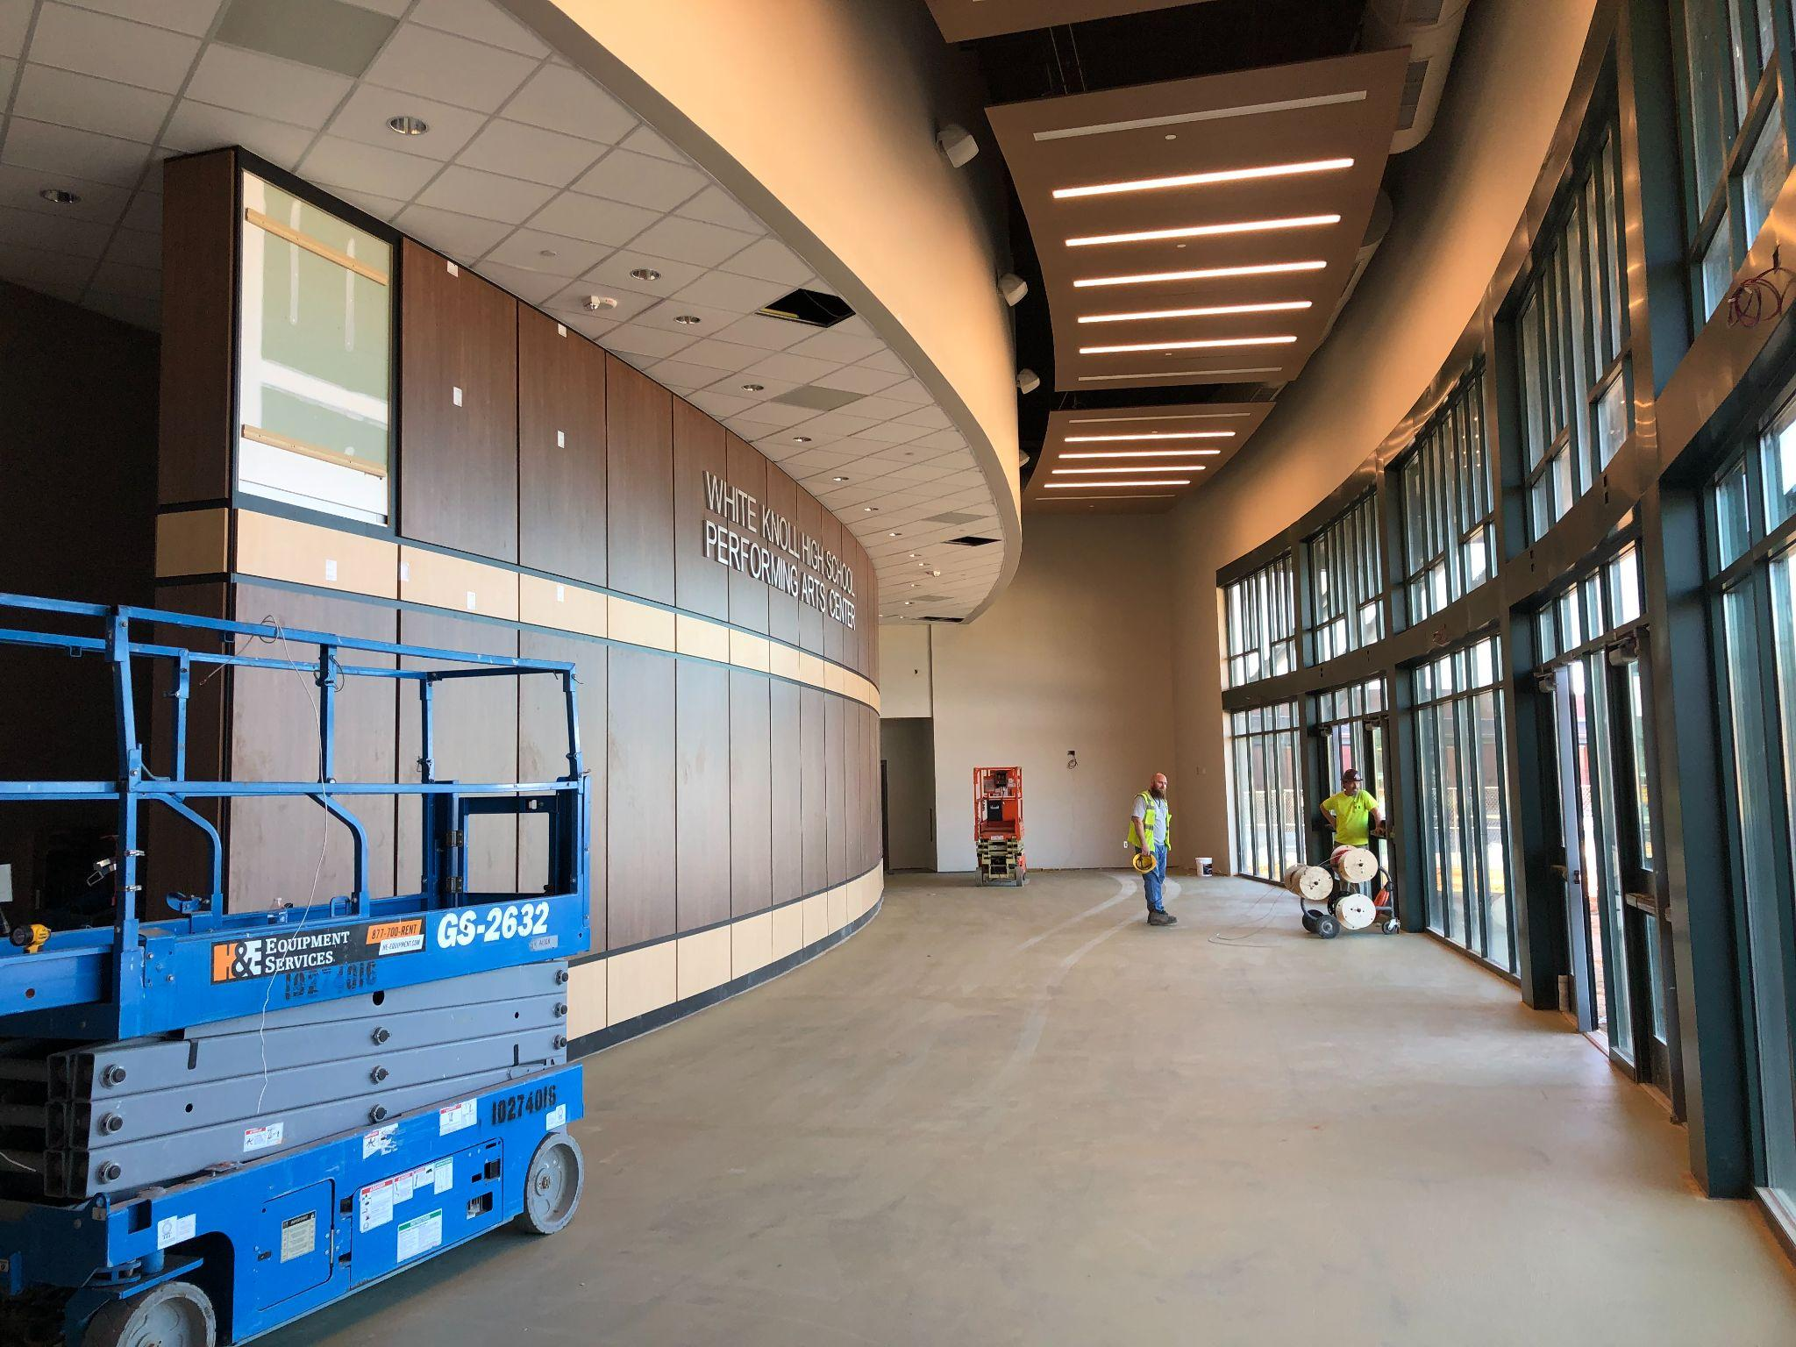
White Knoll High School
Notes:
The lobby space at the White Knoll theatre is nearly completed. Just waiting on hard tile in this space and a few more pieces of the paneling. You see the lettering is installed in the lobby which is a very nice touch.

Slide 22
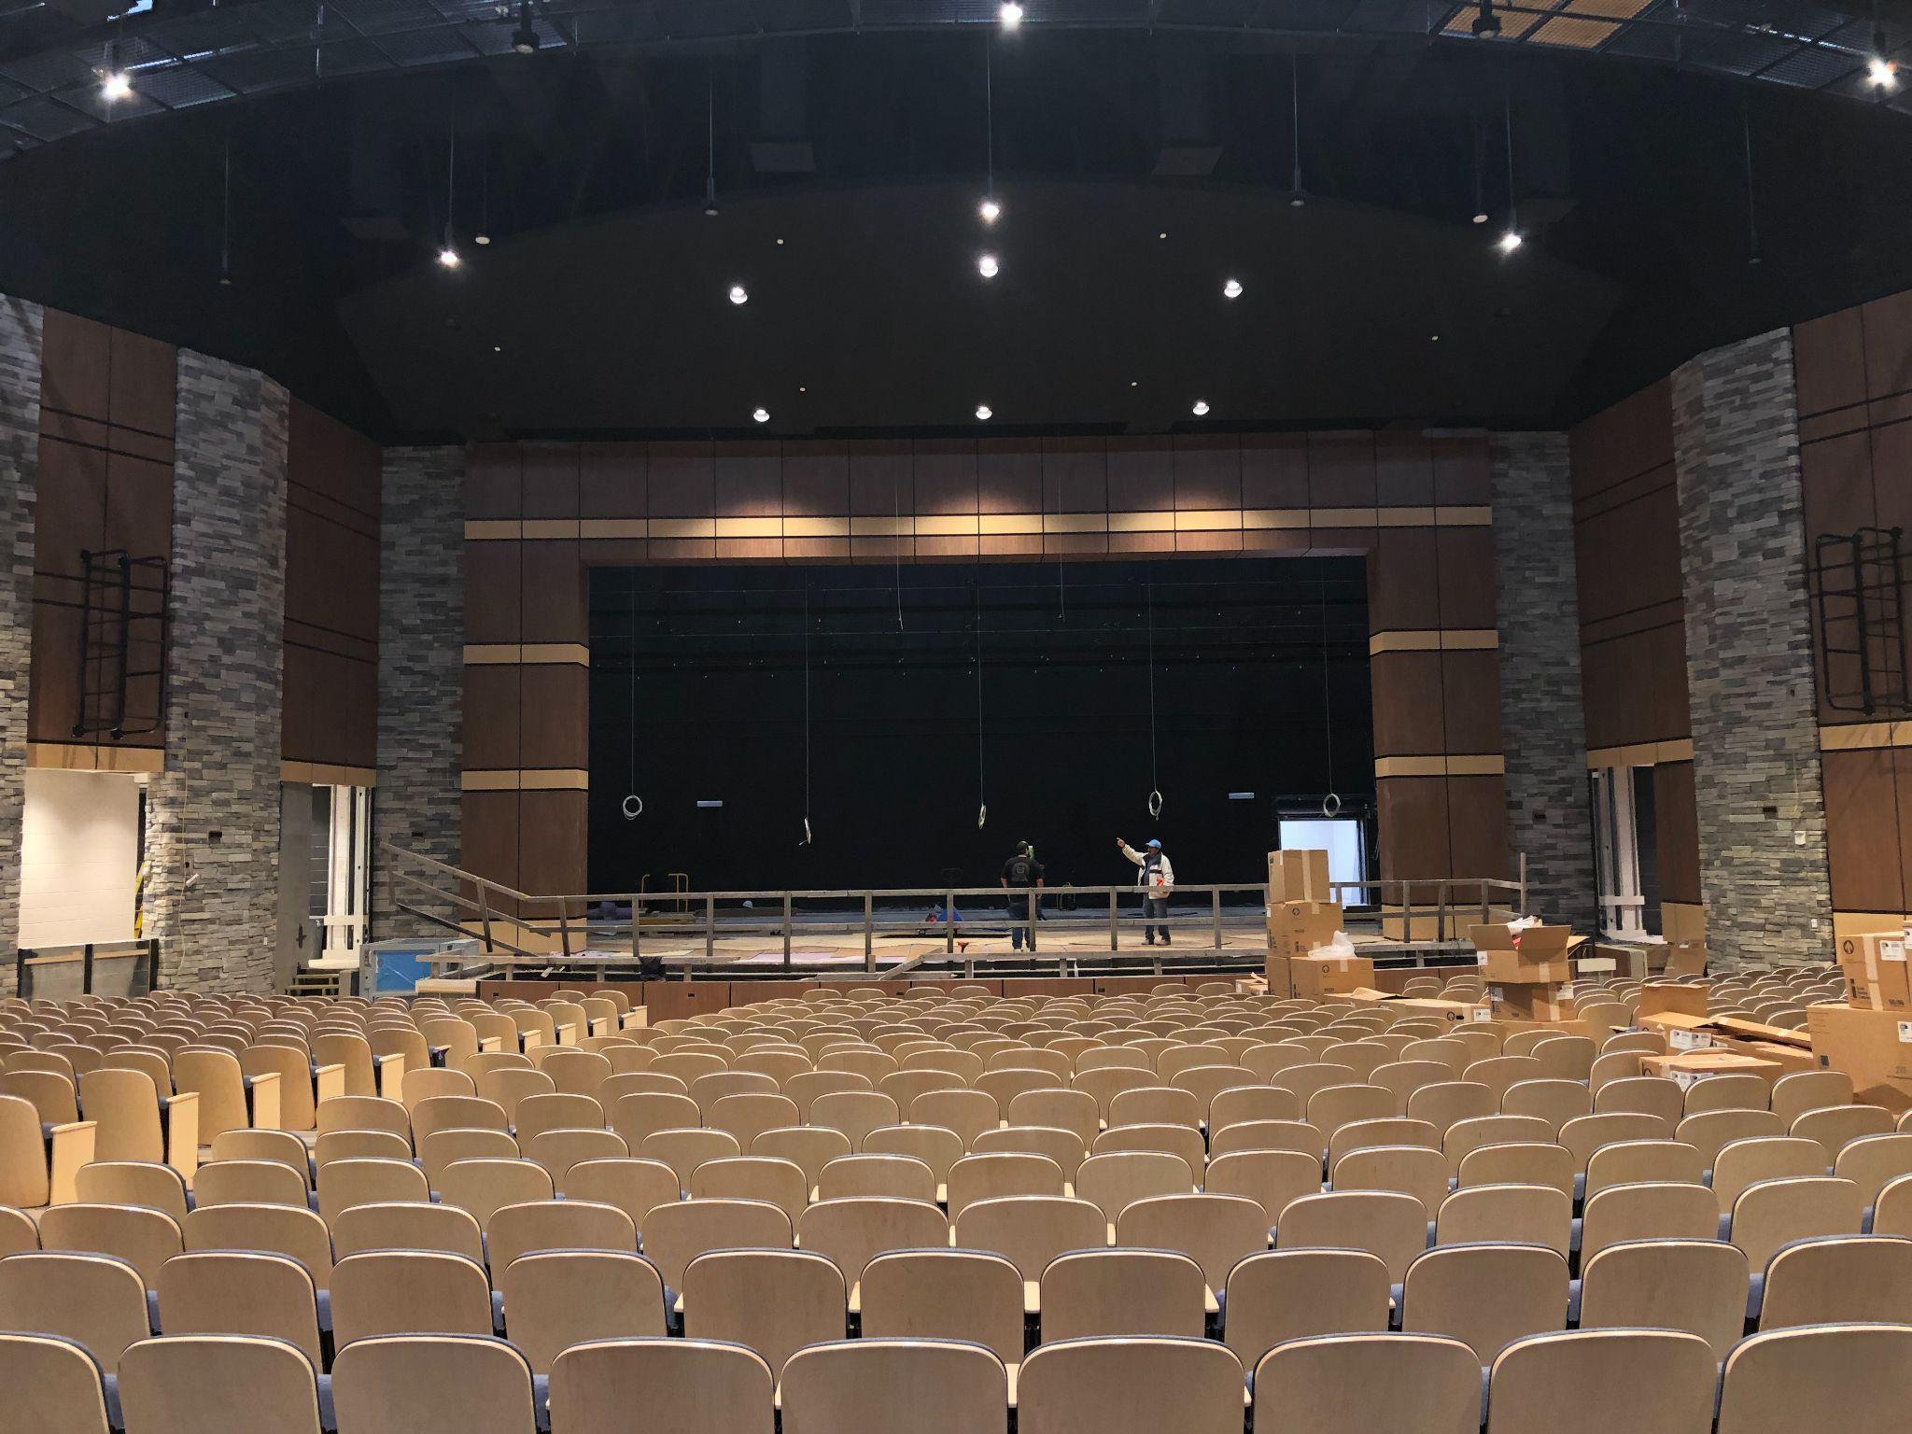
White Knoll High School
Notes:
Seats are installed at the White Knoll theatre and we are just putting some finishing touches on the space including the installation of the stage floor.

Slide 23
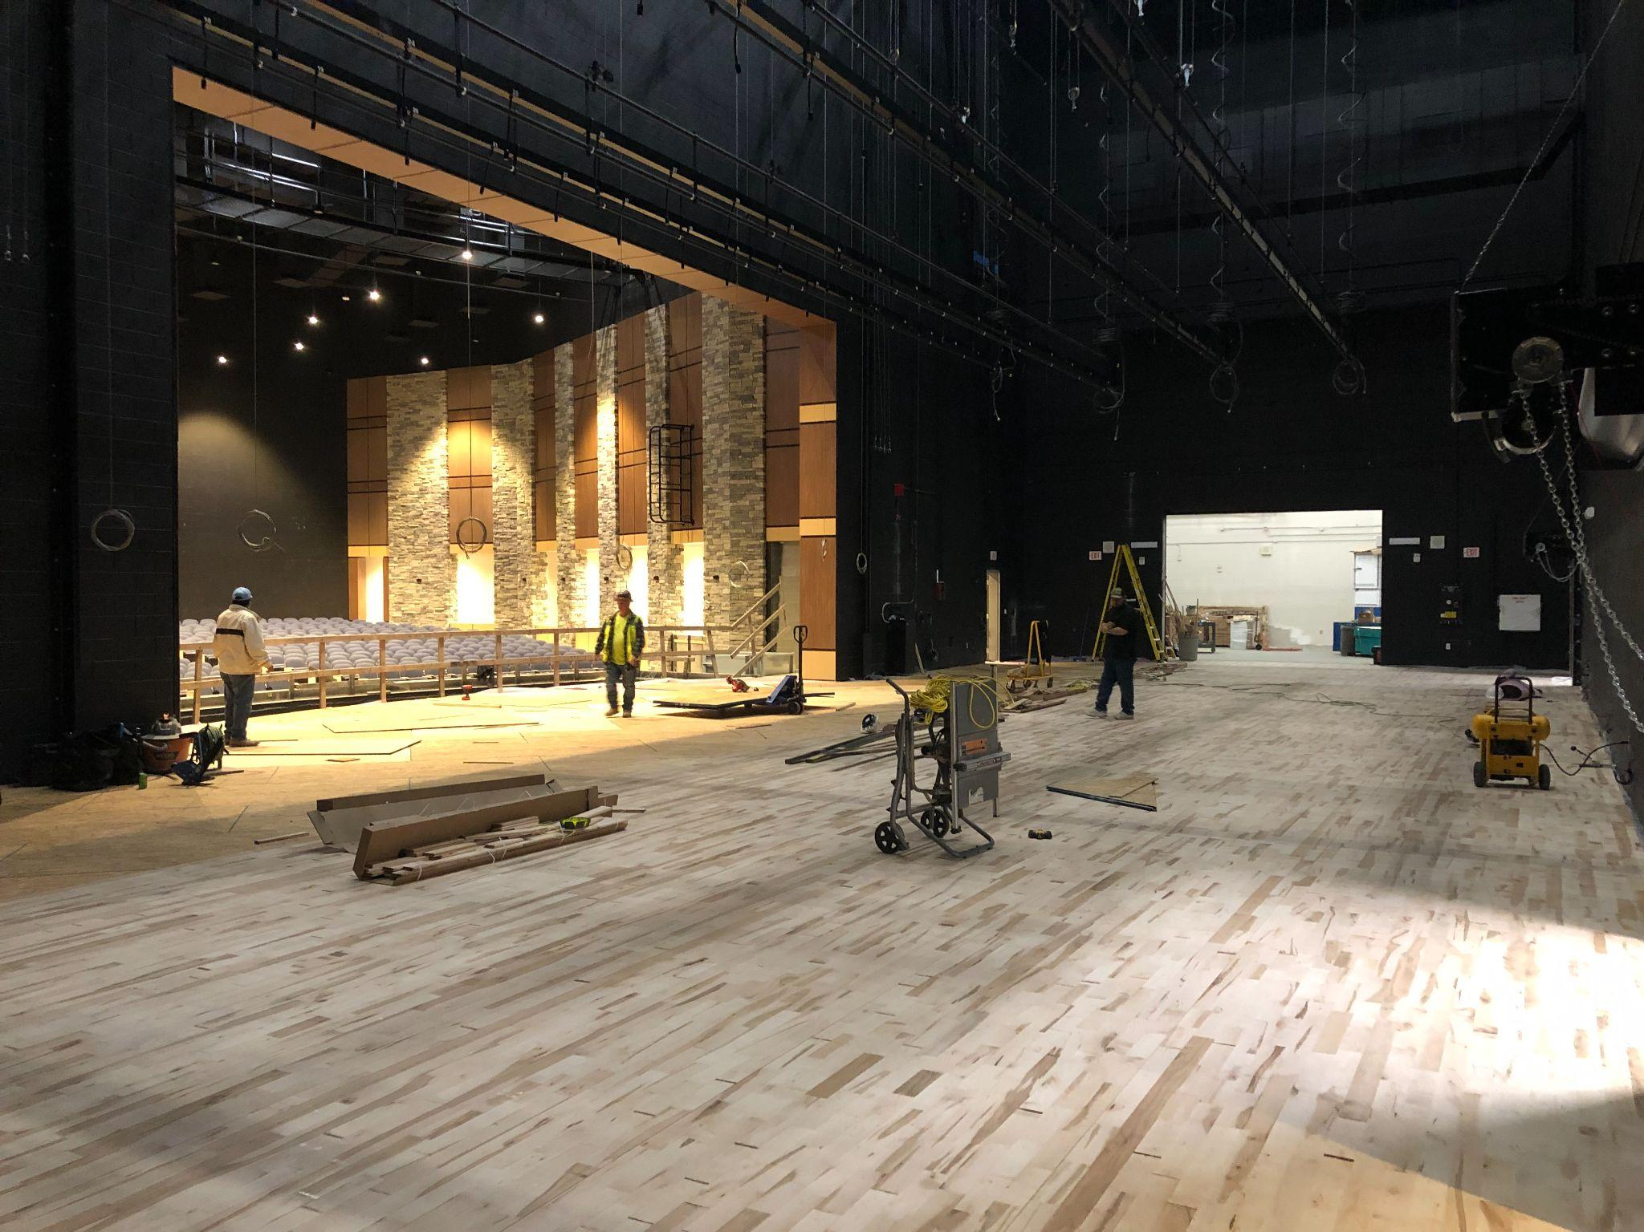
White Knoll High School
Notes:
Here is a photo of that work taking place currently.

Slide 24
White Knoll High School

Slide 25
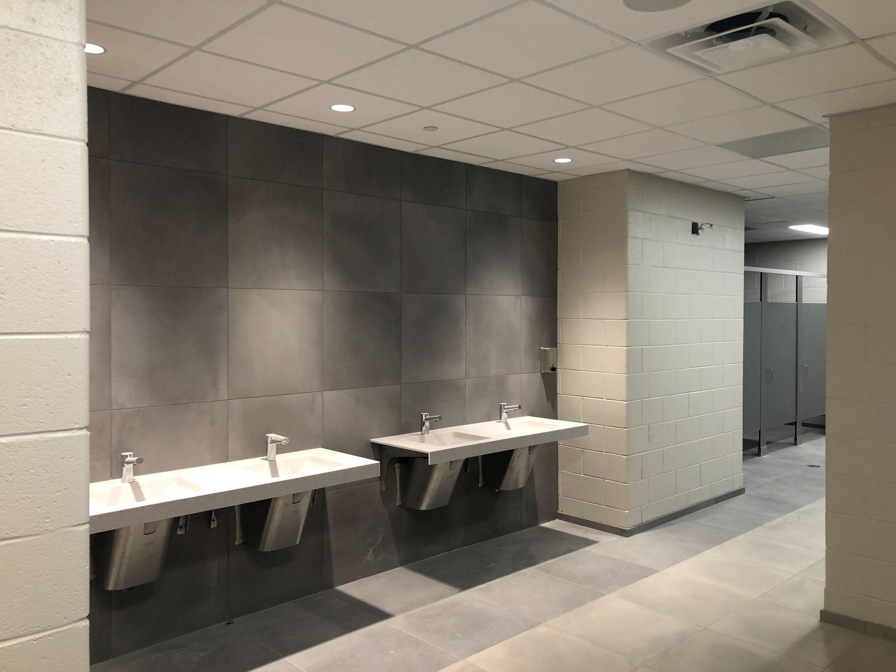
White Knoll High School
Notes:
This is one of the group restroom spaces at the addition as you see the finishes are installed and near completion.

Slide 26
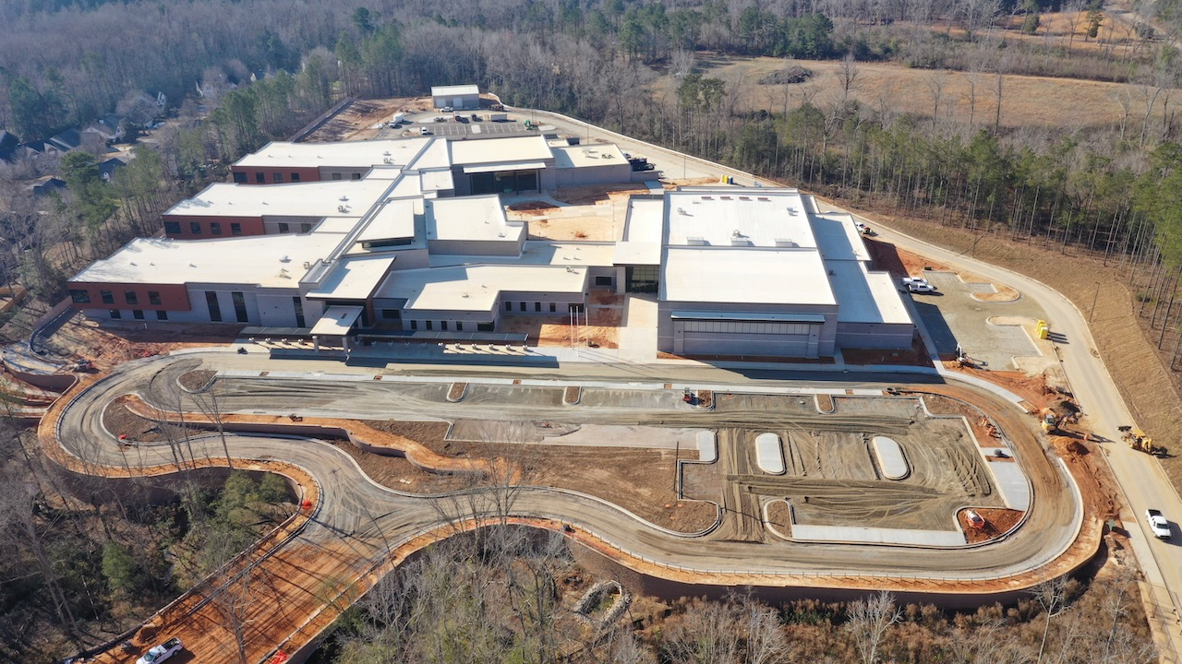
Lakeside Middle
Notes:
Moving to Lakeside Middle and I wanted to begin the progress photos here with an aerial view of the site. The car stacking lane is taking shape as is the front parking lot. Asphalt will soon go down along with parking lot striping. Same goes for the parking lot next to the gym.

Slide 27
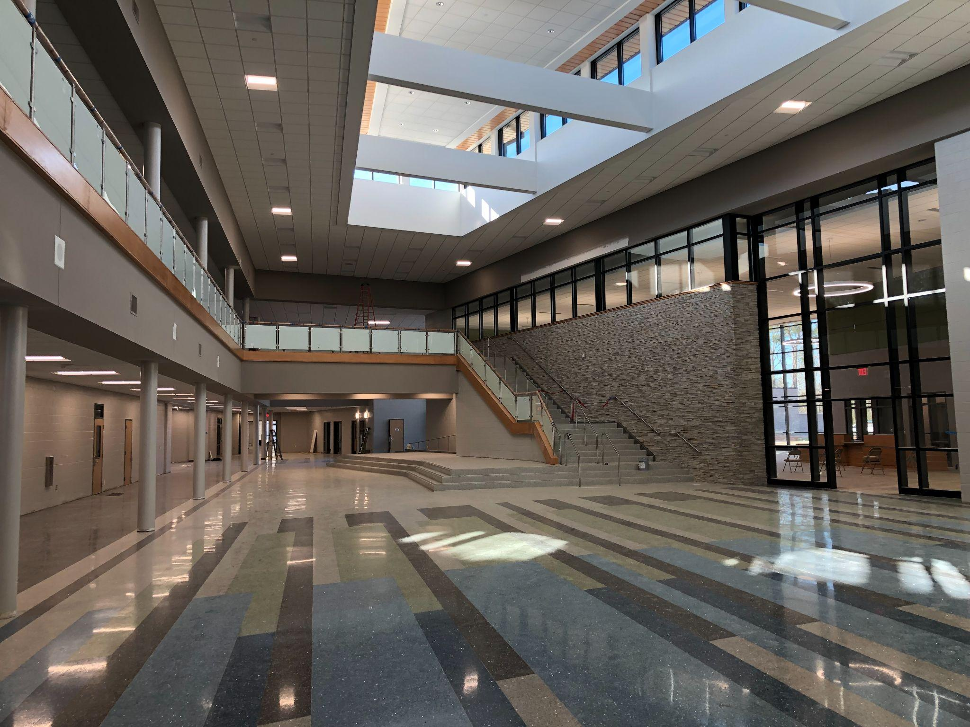
Lakeside Middle
Notes:
The Lakeside commons space looks like we could have school tomorrow. The terrazo has been polished and the floor colors really pop. To the right the learning commons will soon have carpet

Slide 28
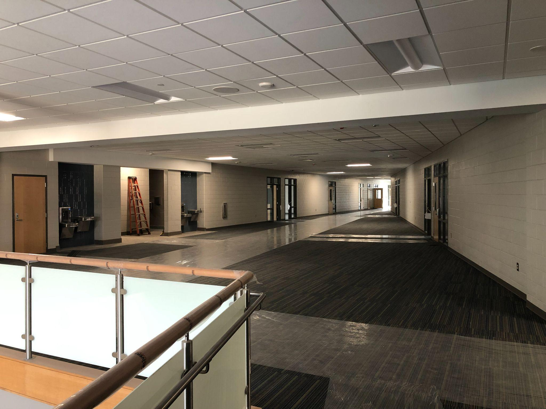
Lakeside Middle
Notes:
This shows one of the upstairs corridors and the installed carpet.

Slide 29
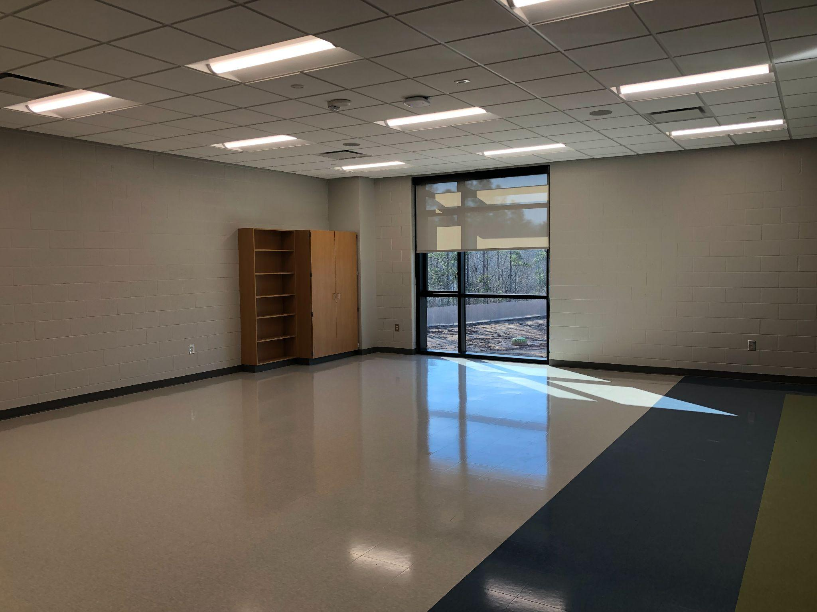
Lakeside Middle
Notes:
This classroom photo shows the floors have been waxed and are ready for furniture and technology.

Slide 30
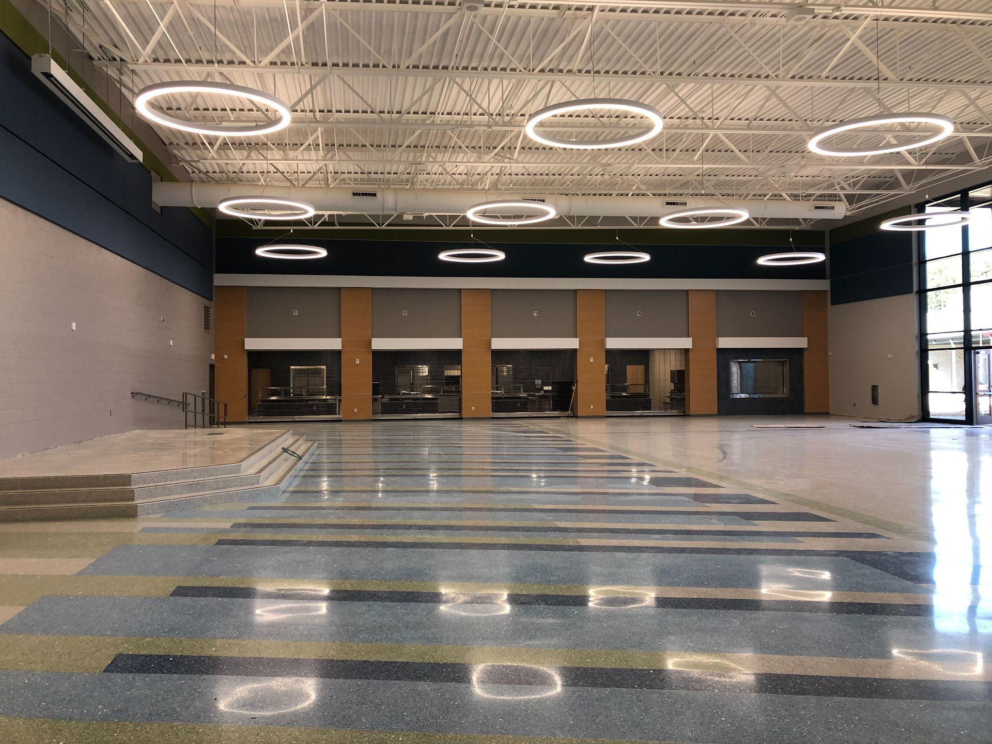
Lakeside Middle
Notes:
The cafeteria space at Lakeside is beautiful. Once again the terrazzo is polished, all the paneling is installed. Just a few minor things left to be done in this space

Slide 31
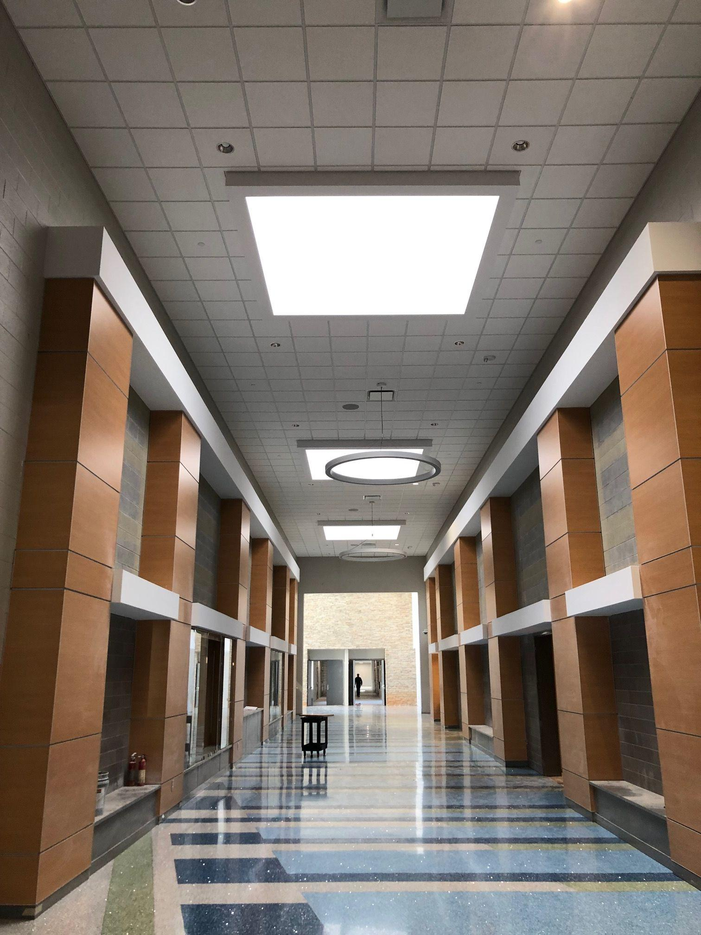
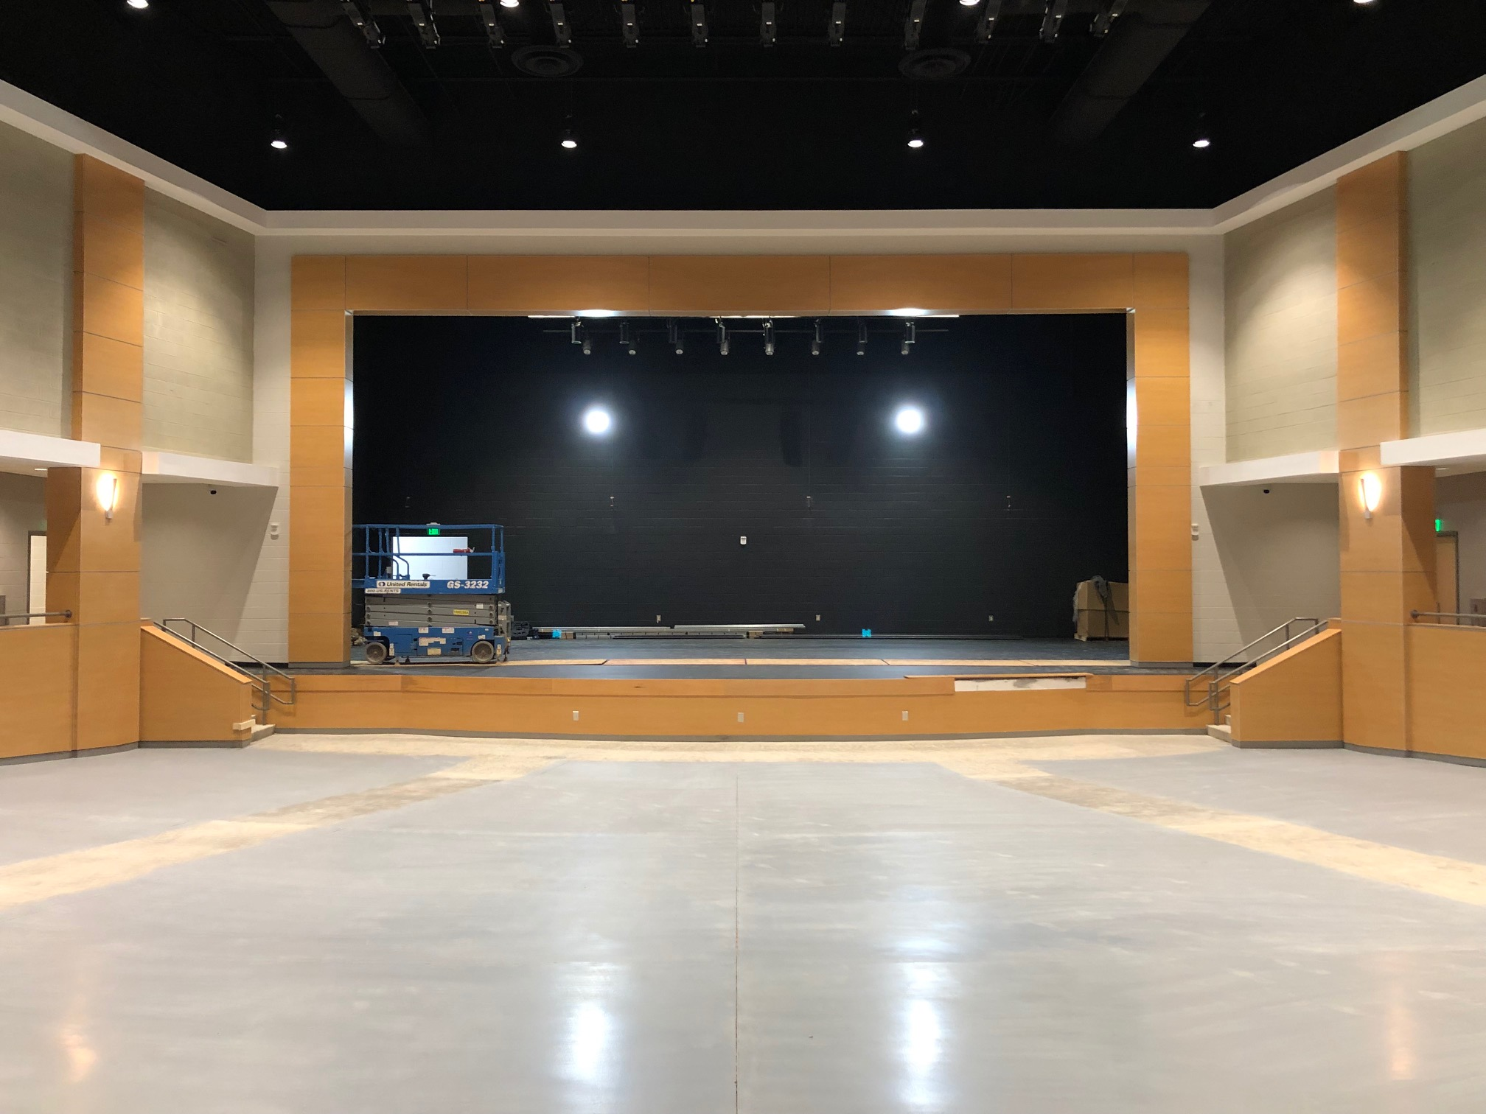
Lakeside Middle
Notes:
These two photos show the commons space between the theatre and gymnasium. Just waiting on sound panels in this space. To the right all the wood is installed in the theatre and waiting to install sound panels and then the seats will be installed.

Slide 32
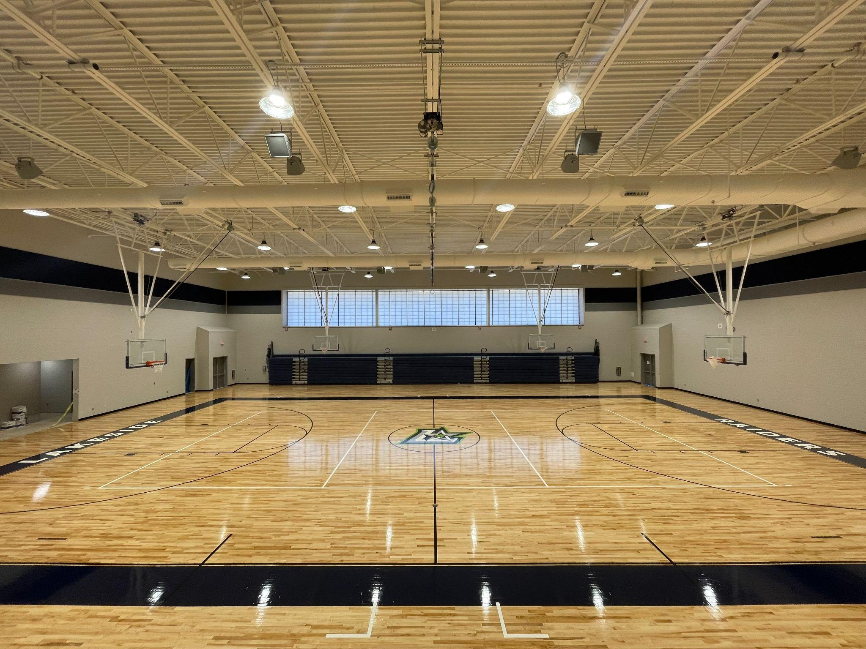
Lakeside Middle
Notes:
If the photo of White Knoll’s theatre was my favorite this is probably #2 from tonight’s presentation. The Lakeside Gym looks practice and game ready. The logo is down and the poly has been applied and it is shining bright.

Slide 33
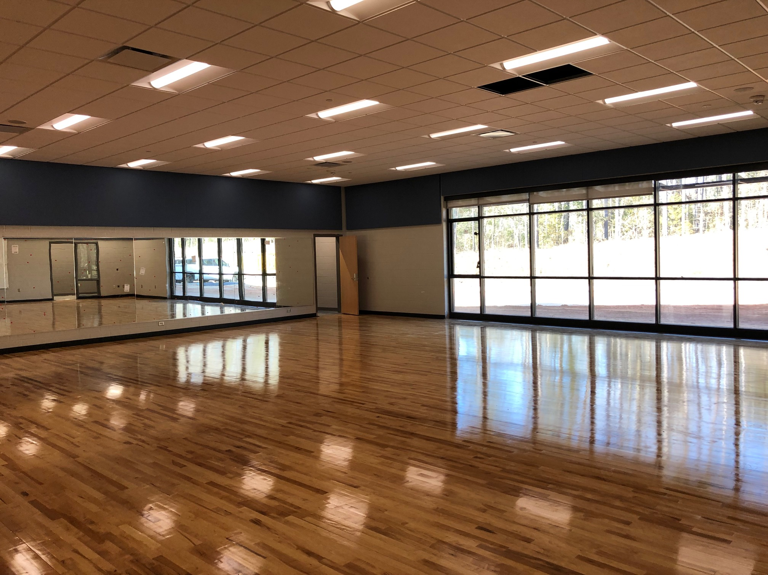
Lakeside Middle
Notes:
Much like the gym the dance room at Lakeside looks ready. The floor is down, mirrors and installed, clear coat has been applied the floor and really is a gorgeous space.

Slide 34
https://www.lexington1.net/Building-Plan

