Slide 6
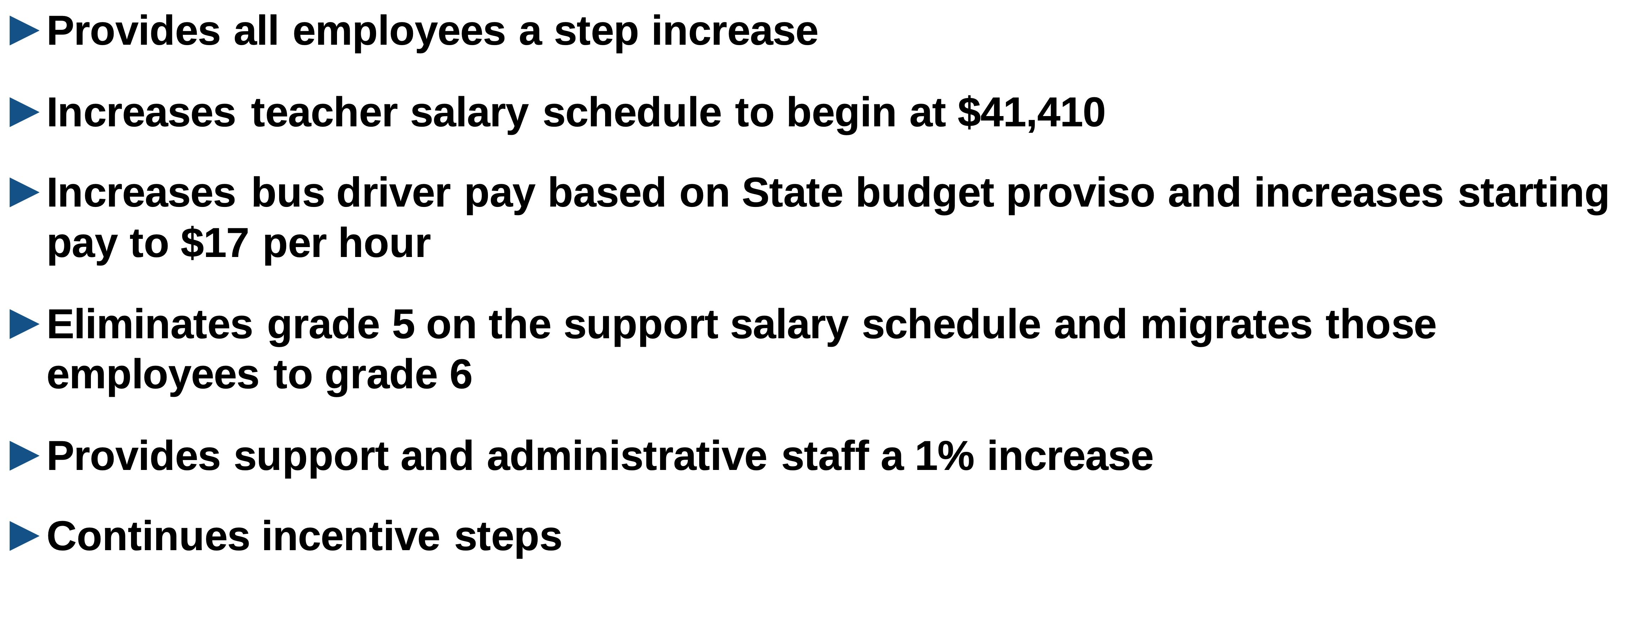

Slide 7
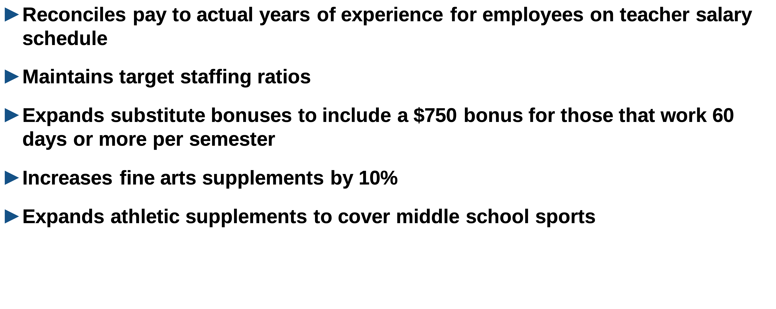

Slide 8
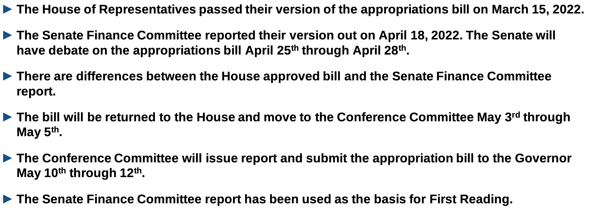

Slide 9
 | House Version | Senate Finance Committee | Change
Revenue Projected for Lexington One under State Aid to Classrooms | $137,325,384 | $144,520,622 | $7,195,238
Hold Harmless Payments | Yes | No
Each district receives same amount of funding as projected to receive for FY21–22 | Yes With Hold Harmless Payment | Yes Stake in the ground funding
Requires 25% local match on EIA portion of FY21–22 of funding to be received in FY22–23 | Yes | No
Increase to each cell in State minimum teacher salary schedule | $4,000 | $2,000 | ($2,000)
Requires local percent of teacher salary to remain the same as it is in FY21–22 in FY22–23 | Yes | No
Career center funding will remain the same as FY21-22 funding for FY22-23 | No | Yes

Slide 11
Year | *Membership | Increase (Decrease) | Percent
2016–17 | 24,895 | 477 | 2.0%
2017–18 | 25,511 | 616 | 2.5%
2018–19 | 25,999 | 488 | 1.9%
2019–20 | 26,507 | 508 | 1.9%
2020–21 | 26,346 | (161) | (0.6%)
2021–22** | 27,082*** | 736 | 2.8%
2022–23**** | 27,692 | 610 | 2.3%

Slide 12
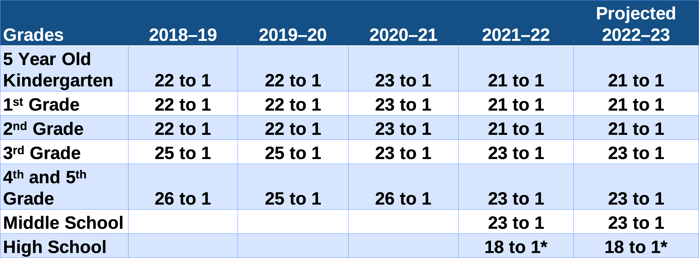

Slide 14
Category | FTE | Amount
Certified and Licensed Professionals – Elementary School | 26.00 | $1,764,997
Certified and Licensed Professionals – Middle School | 1.50 | 108,406
Certified and Licensed Professionals – High School | 2.00 | 144,540
School Counselor – High School | 1.00 | 72,271
Certified Positions – District Wide (ESOL, Lead Teachers) | 1.80 | 130,086
Interventionists – Middle School | 4.00 | 289,079
Interventionists – Elementary School | 5.75 | 415,553
Math Coach – Middle School | 1.00 | 72,270
Behavior Interventionists – Elementary School | 5.00 | 361,349
Certified and Licensed Professionals – Special Needs | 12.20 | 881,694
Funding Modification shift due to new funding plan from At Risk | 3.42 | 273,422
Pool Positions | 6.00 | 433,619
Total Net Changes | 69.67 | $4,947,286

Slide 15
Category | FTE | Amount
Certified and Licensed Professionals – Middle School | 9.00 | $ 650,426
Behavioral Health Counselor | 1.00 | 72,270
Interventionists – Middle School | 4.00 | 289,079
Total Net Changes | 14.00 | $1,011,775

Slide 16
Category | FTE | Amount
Support Staff – Instructional | 10.00 | $ 380,915
Support Staff – Non-instructional | 10.00 | 492,187
Support Staff – Instructional – Special Needs | 12.00 | 493,470
School Administrator – Assistant Principal (LMS & WKMS) | 2.00 | 231,968
Central Services Staff | 3.00 | 258,656
Total Net Changes | 37.00 | $1,857,196

Slide 17
Category | General Fund FTE | General Fund Amount | ESSER FTE | ESSER Amount | Total Additional FTE | Total Additional Amount
Certified and Licensed Professionals – Elementary School | 26.00 | $1,764,997 |  |  | 26.00 | $1,764,997
Certified Licensed Professionals – Middle School | 1.50 | 108,406 | 9.00 | 650,429 | 10.50 | 758,835
Certified and Licensed Professionals – High School | 2.00 | 144,540 |  |  | 2.00 | 144,540
School Counselor – High School | 1.00 | 72,271 |  |  | 1.00 | 72,271
Certified Positions – District Wide (ESOL, Lead Teachers) | 1.80 | 130,086 |  |  | 1.80 | 130,086
Interventionists – Elementary School | 5.75 | 415,553 |  |  | 5.75 | 415,553
Interventionists – Middle School | 4.00 | 289,079 | 4.00 | 289,079 | 8.00 | 578,158
Math Coach – Middle School | 1.00 | 72,270 |  |  | 1.00 | 72,270
Behavior Interventionists – Elementary School | 5.00 | 361,349 |  |  | 5.00 | 361,349
Behavior Health Counselor | - | - | 1.00 | 72,270 | 1.00 | 72,270
Certified and Licensed Professionals – Special Needs | 12.20 | 881,694 |  |  | 12.20 | 881,694
Funding modification shift due to new funding plan for At Risk | 3.42 | 273,422 |  |  | 3.42 | 273,422
Pool Positions | 6.00 | 433,619 |  |  | 6.00 | 433,619
Support Staff – Instructional | 10.00 | 380,915 |  |  | 10.00 | 380,915
Support Staff – Non-instructional | 10.00 | 492,187 |  |  | 10.00 | 492,187
Support Staff – Instructional – Special Needs | 12.00 | 493,470 |  |  | 12.00 | 493,470
School Administrator – Assistant Principal | 2.00 | 231,968 |  |  | 2.00 | 231,968
Central Services Administrative Staff | 3.00 | 258,656 | _____ | __________ | 3.00 | 258,656
Total Net Changes | 106.67 | $6,804,482 | 14.00 | $1,011,778 | 120.67 | $7,816,260

Slide 18
Category | Amount
Step increase for all eligible employees | $3,710,564
State mandated employer retirement and health insurance increase | 5,314,229
Certified salary schedule adjustment | 5,385,571
Bus driver salary schedule increase based on state budget proviso with additional starting pay starting at $17/hour | 455,094
1% increase for certified, support and administrative staff | 2,303,039
Athletic supplement increases and additions | 159,162
Fine arts supplement increases | 13,797
Substitute retention bonuses | 172,475
Eliminate grade 5 on support salary schedule and migrate employees to grade 6 | 547,378
Reconcile pay to actual years of experience for certified staff over step 31 | 197,211
Supplements, temporary salaries and other adjustments | 237,847
Total Other Salaries and Related Fringes Increases | $18,496,367

Slide 19
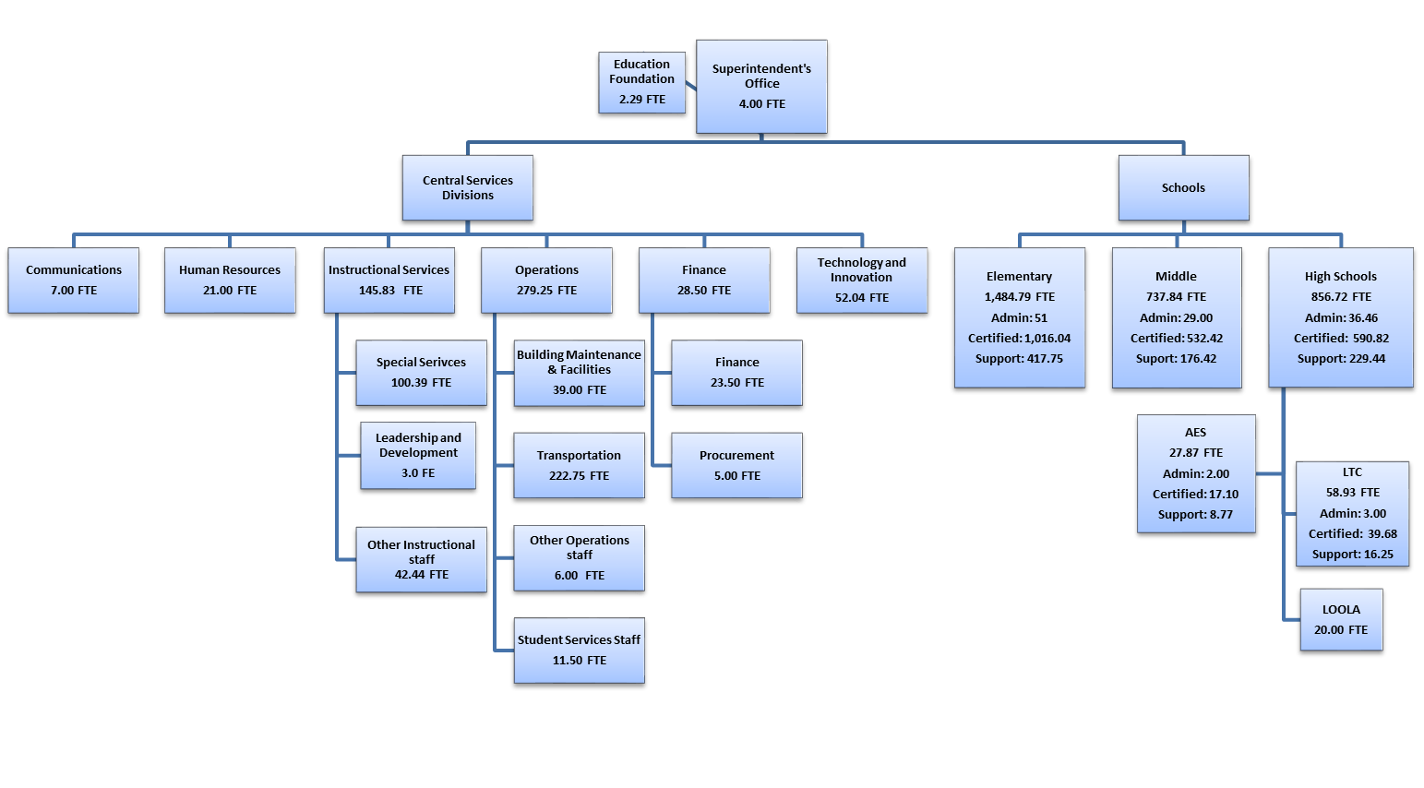

Slide 20
Category | Amount
Instructional Services Division
Contractual Services | $175,292
Residential Care Services for Students | 100,000
USC Masters Cohort – Teachers Reimburse District with Payroll Deductions | 160,680
Travel | 108,991
Human Resources Division
Workers Compensation Insurance | 526,553
Staff Services International Teachers | 123,825
Information Technology Division
Technology Supplies and Software | 293,772
Operations Division
Utilities | 422,902
Maintenance Department | 536,597
Property and Casualty Insurance | 282,500
Student Services Division
Health and Transportation Departments | 154,758
School Allocations | 90,631
Total Increase Over Prior Year | $2,976,501

Slide 21
Category | Amount
Communications Division | $25,170
Operations Division
Safety and Emergency Services Department | 43,258
Maintenance Department – Grounds | 646,160
Accounts Payable recorded at 93% of total based on historical data | 2,649,022
Total Decrease Over Prior Year | $3,363,610

Slide 22
 | *Amended Budget FY 2022 | Proposed Budget FY 2023 | Increase (Decrease)
Salaries and Related Costs | $279,072,230 | $290,395,730 | $11,323,500
Programs and Services | 35,563,386 | 35,176,277 | (387,109)
Total Budget | $314,635,616 | $325,572,007 | $10,936,391

Slide 25
 | *Amended Budget FY 2022 | Proposed Budget FY 2023 | Increase (Decrease)
Local Sources | $104,039,354 | $106,656,500 | $ 2,617,146
State Sources | 183,701,677 | 199,835,529 | 16,133,852
Transfers From Other Funds | 8,834,807 | 12,944,860 | 4,110,053
Operational Balance | 18,059,778 | 6,135,118 | (11,924,660)
 | $314,635,616 | $325,572,007 | $ 10,936,391

Slide 26
Fiscal Year | Tax Year | Millage Rate Increase Limitation | Actual Increase | Lookback Used | Millage Levied | **Currently Available For Lookback
2017–18 | 2017 | 11.96 | 11.96 | 0 | 317.95
2018–19 | 2018 | 14.27 | 4.45 | 0 | 322.40
2019–20 | 2019 | 15.21 | 0 | 0 | 322.40 | 15.21
2020–21 | 2020* | 12.82 | 0 | 0 | 308.86 | 12.82
2021-22 | 2021 | 11.03 | 0 | 0 | 308.86 | 11.03
2022-23 | 2022 | 25.39 | TBD | TBD*** | TBD | TBD

Slide 27
Calculation of Allowable Millage Increase
FY2022 Millage Rate | 308.86
x Estimated Allowable Percentage Increase | 8.22%
FY 2023 Current Year Estimated Allowable Millage Increase | 25.39
FY 2023 Total Recommended Millage Increase | 0
x Value of a Mill | $320,175
Revenue Generated by Recommended Millage Increase | 0
Potential Revenue Generated Using Estimated Total Allowable | $8,129,243

