Slide 1
Operations Update
May 17, 2022

Slide 2
Capital Project Update
Notes:
Good Evening Dr. Little, Madam Chair, Members of the board I am excited to be here tonight to provide the May operations update. Tonight we are going to focus on Capital projects funded through the 8% Bond Sale issued last October for facility improvement use. Many of these projects have been completed with more work scheduled for this summer. As you know these are projects additional to our bond referendum work so it has been a busy year for us. Also, recently we have met with several of you to discuss format for the Operations update moving forward. I have had some discussions with our design firms about a possible shift in our presentations and we look forward to direction from you Board on next steps.

Slide 3
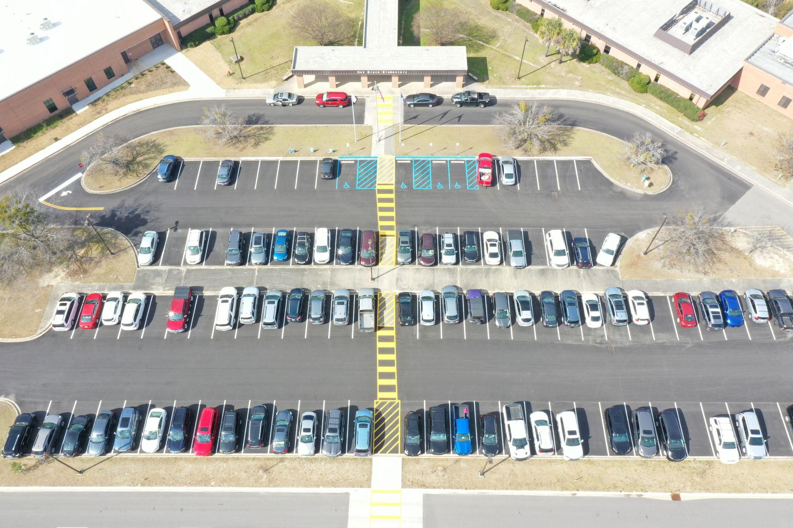
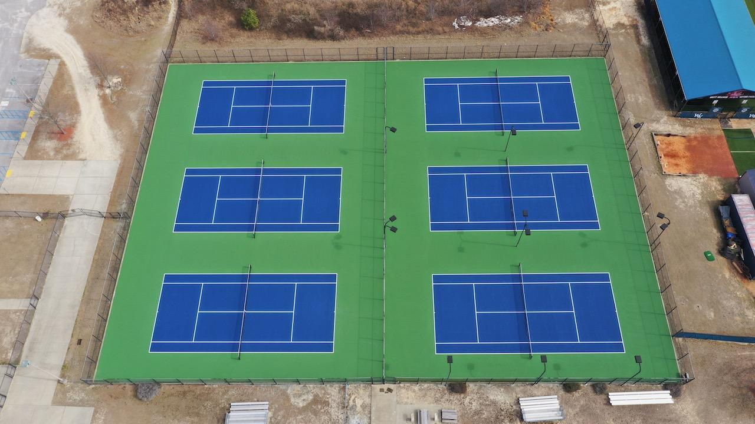
Review of Completed Work (February Board Meeting)
OGES PARKING LOT RESURFACING
WKHS TENNIS COURT RESURFACING

Slide 4
Gilbert Middle School
Classroom HVAC and partial rooftop replacement
Replace group restroom toilet partitions
Media center lighting replacement
Scheduled Summer 2022

Slide 5
Lake Murray Elementary School
HVAC and roof replacement related arts wing, cafeteria, and main office
Hardware on exterior doors replaced and doors repainted
Scheduled Summer 2022

Slide 6
Furniture Acquisition
Lake Murray Elementary
Red Bank Elementary
New Providence Elementary
Pleasant Hill Elementary
Carolina Springs Elementary
Gilbert Elementary
Oak Grove Elementary
Pelion Elementary
Gilbert Middle
Gilbert High
Pelion High

Slide 7
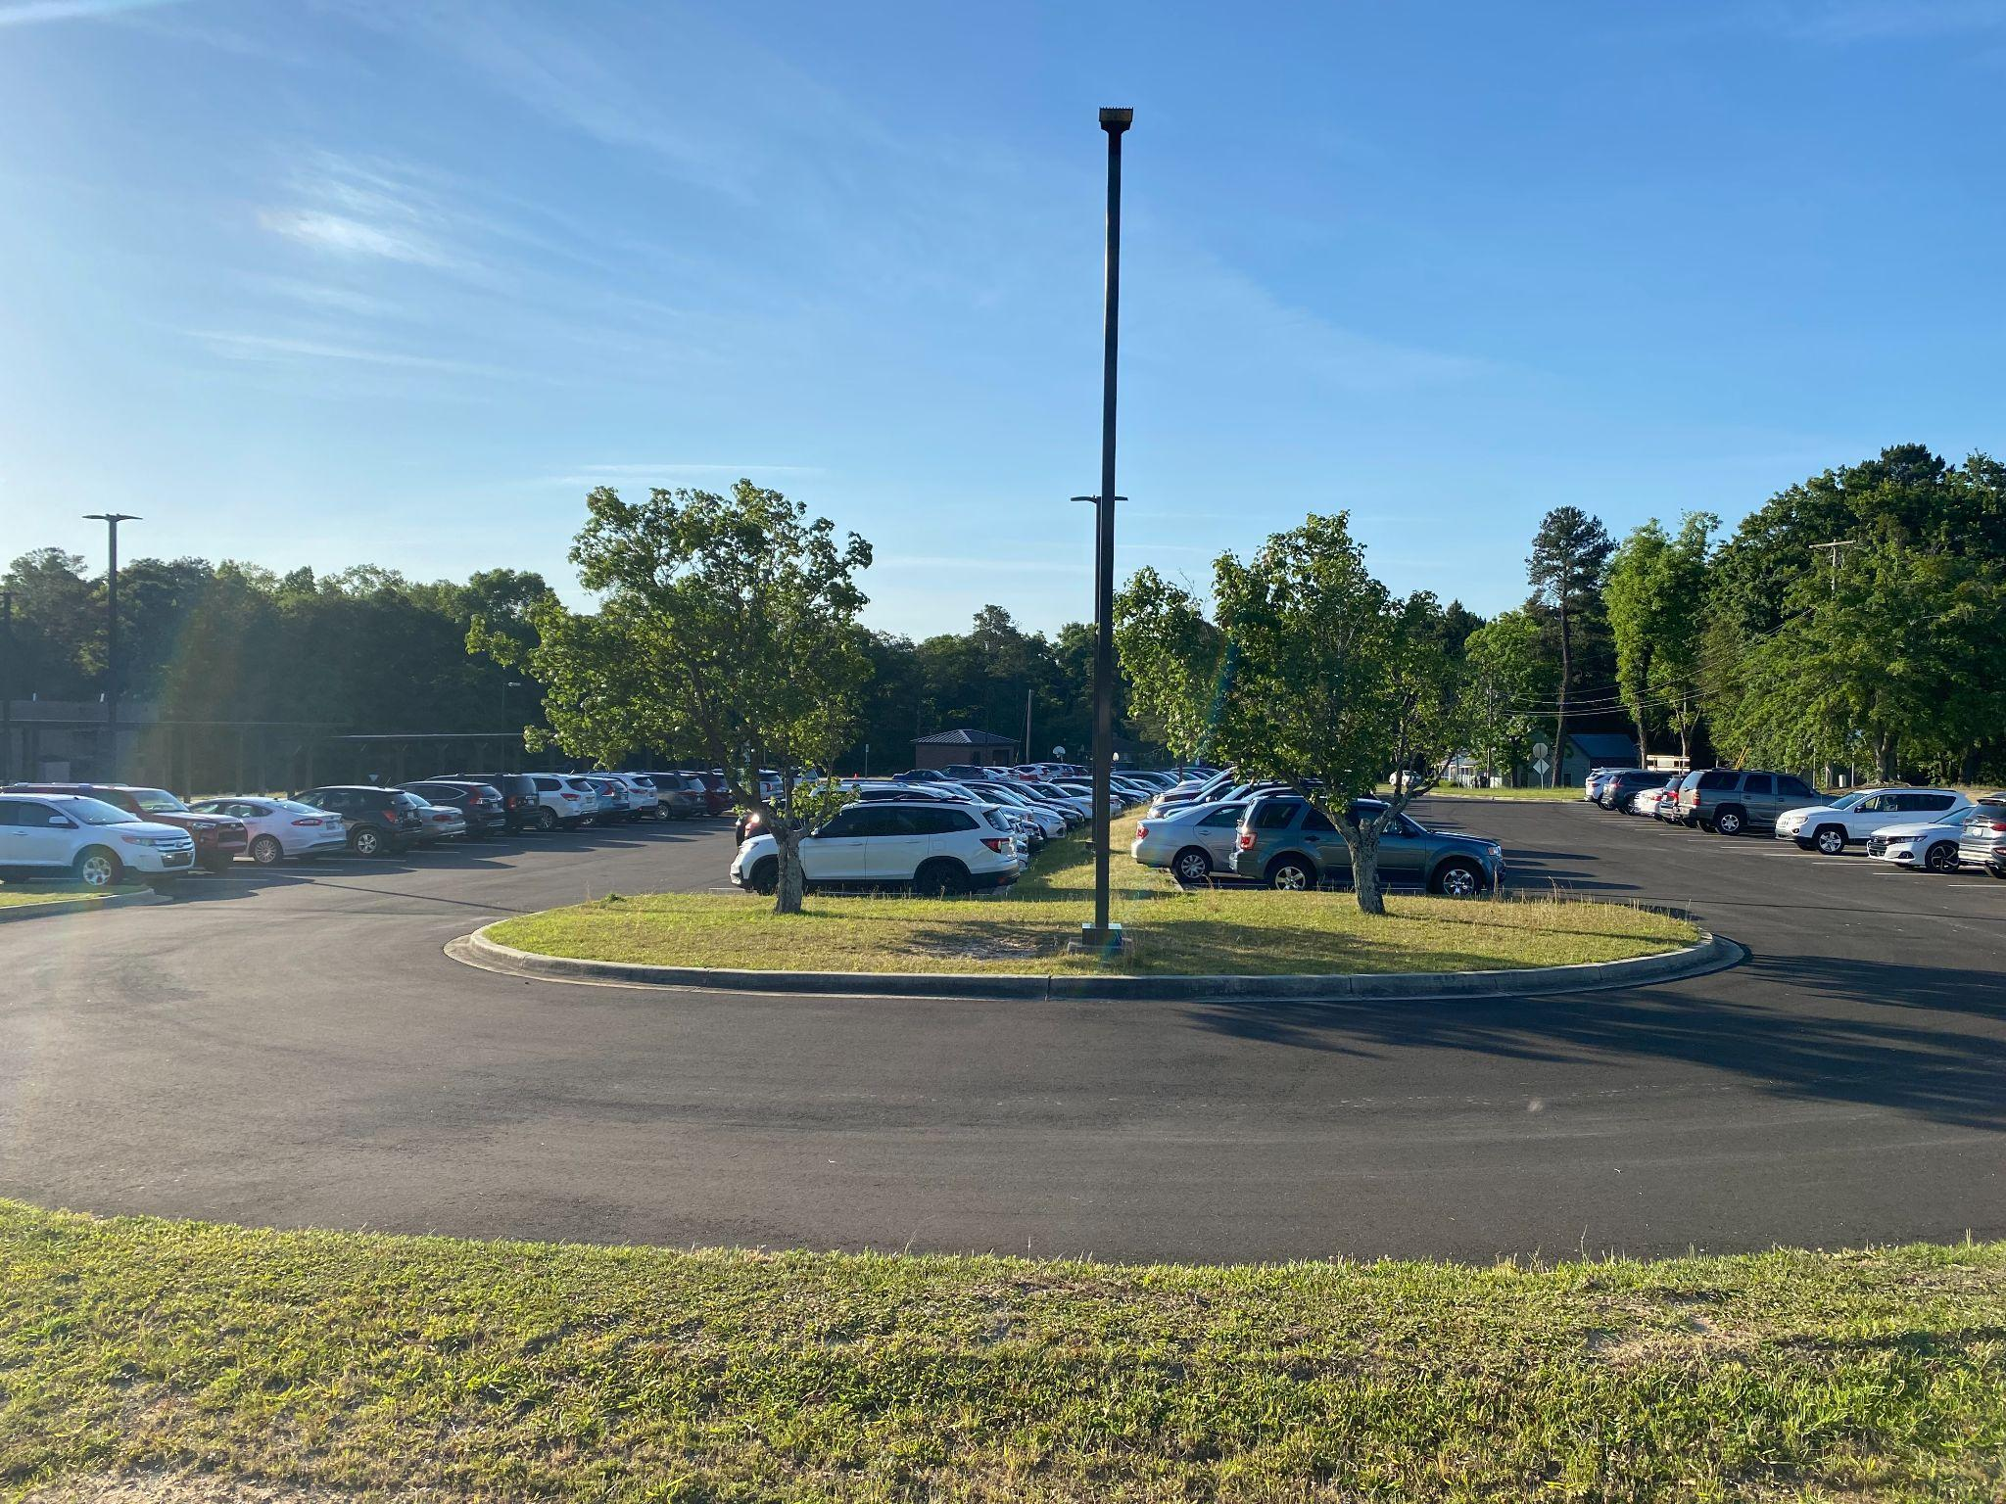
Lexington Elementary School

Slide 8
White Knoll Middle School
Kitchen water heater replacement
Work will be completed Summer 2022 (water heater on site)

Slide 9
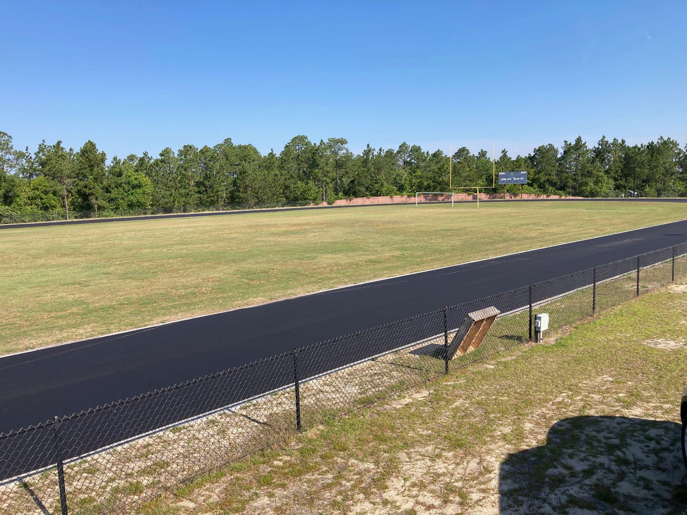
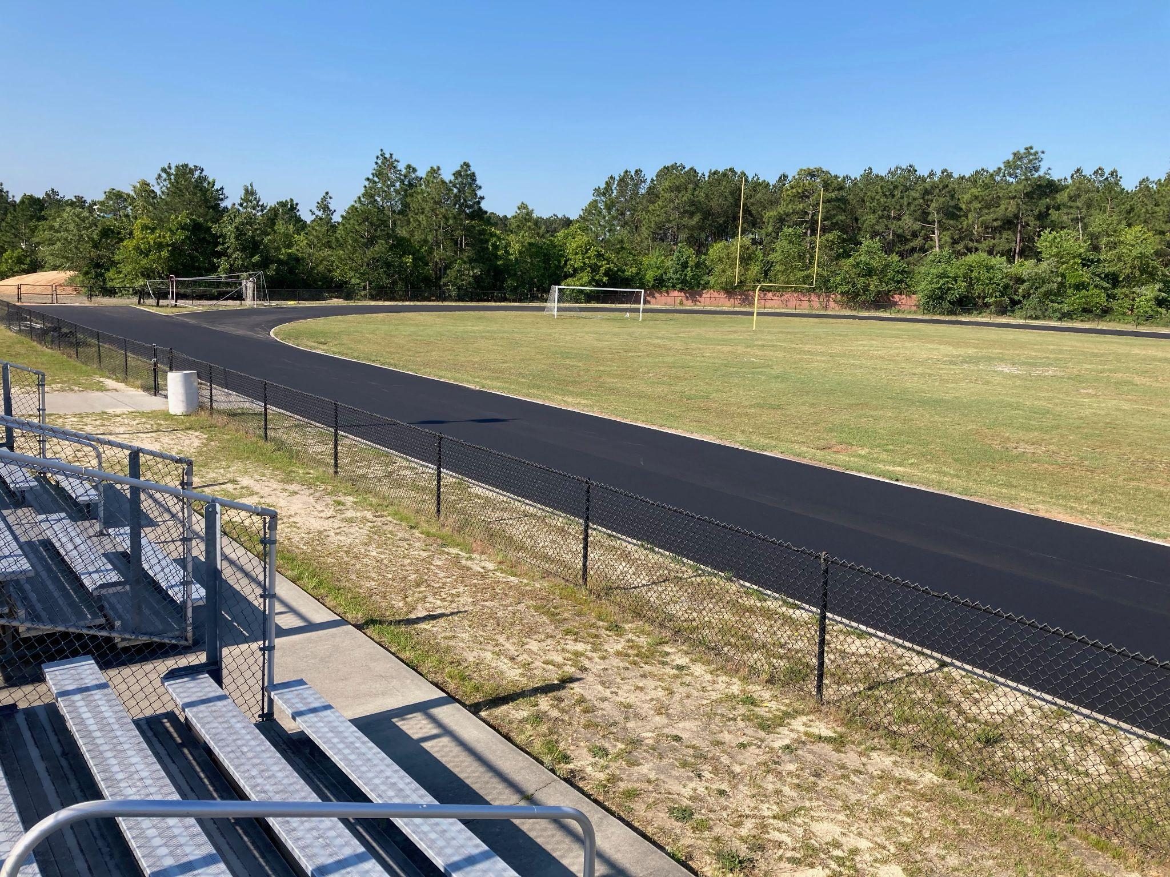
Middle School Track Paving
CAROLINA SPRINGS MIDDLE SCHOOL
Notes:
As part of this funding we are paving our middle school tracks. Here are some photos of the work being done at CSMS as it nears completion.

Slide 10
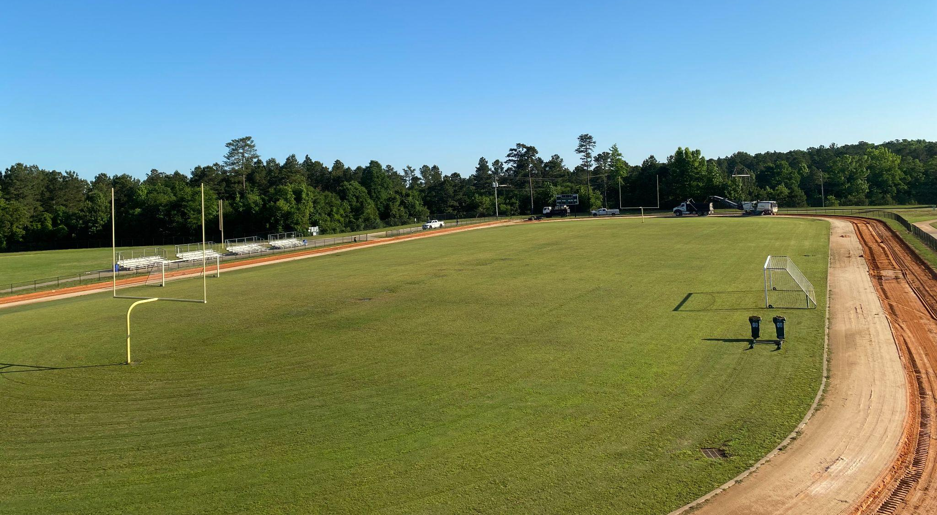
Middle School Track Paving
MEADOW GLEN MIDDLE SCHOOL
Notes:
Moving on to MGMS you see work has started on their track and should be completed in the next few weeks. Track paving at Pleasant Hill Middle will be completed this summer. Once PHMS is completed all of our middle schools will have paved tracks.

Slide 11
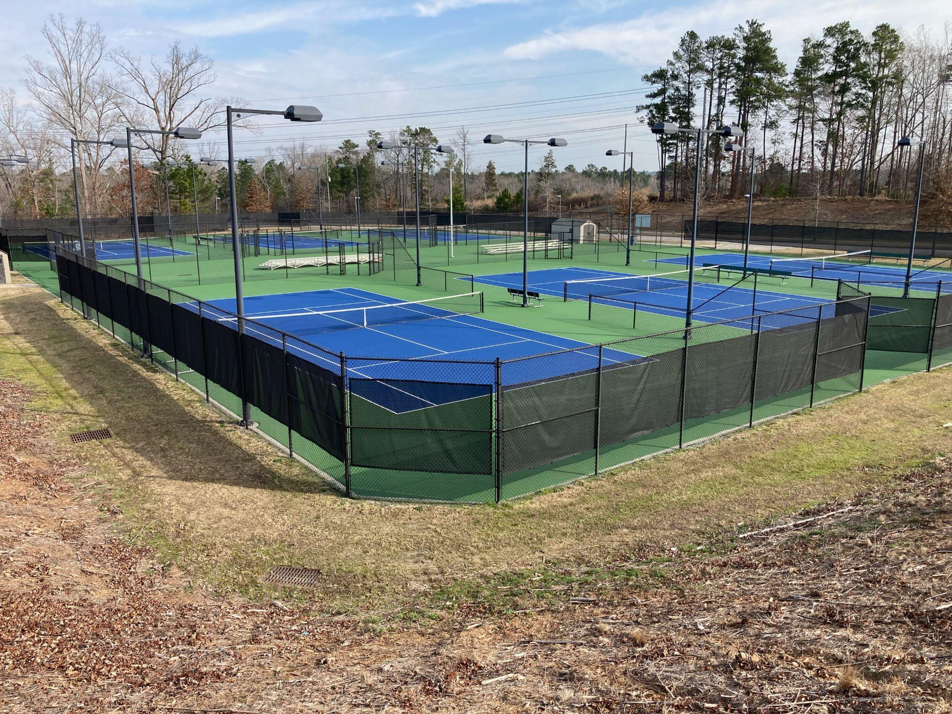
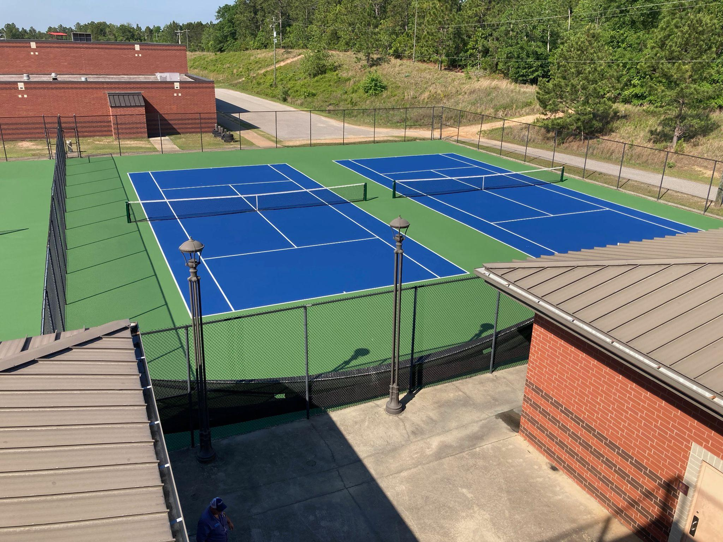
Tennis Court Resurfacing
RIVER BLUFF HIGH SCHOOL
PELION HIGH SCHOOL
Notes:
Gilbert High School’s tennis courts will be resurfaced this summer.

Slide 12
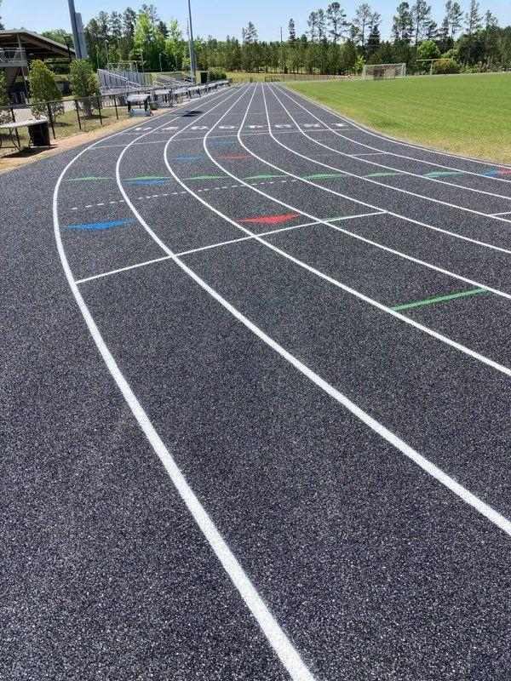
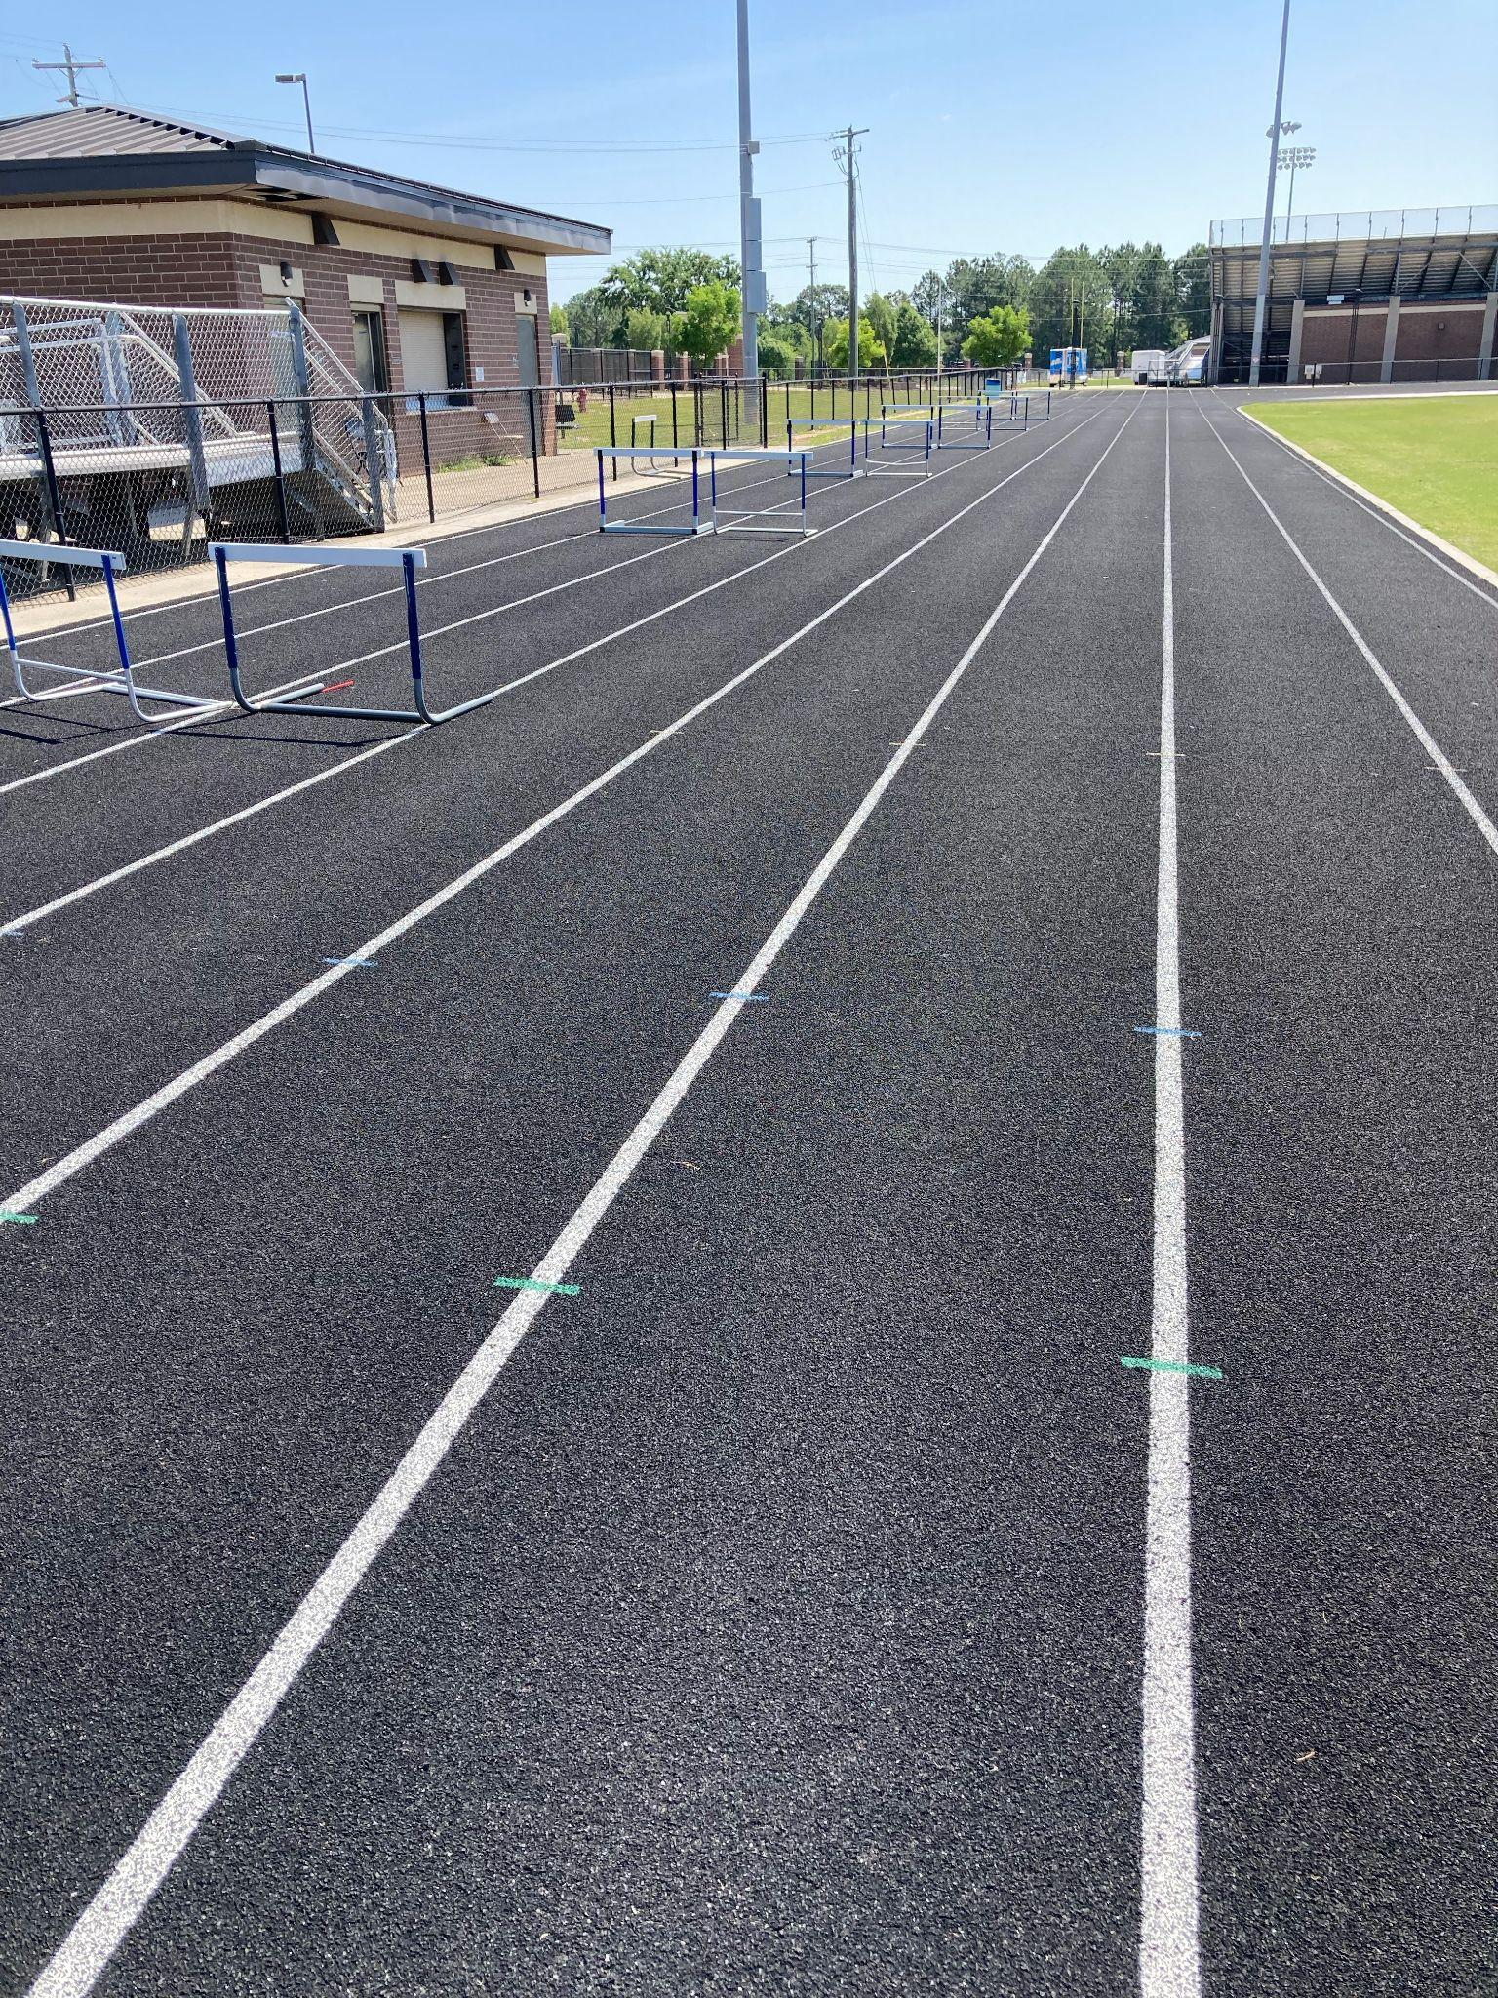
Repair/Resurface Competition Tracks
RIVER BLUFF HIGH SCHOOL
LEXINGTON HIGH SCHOOL
Notes:
GHS track widening project is scheduled to begin this summer. The track will be widened to 8 lanes.

Slide 13
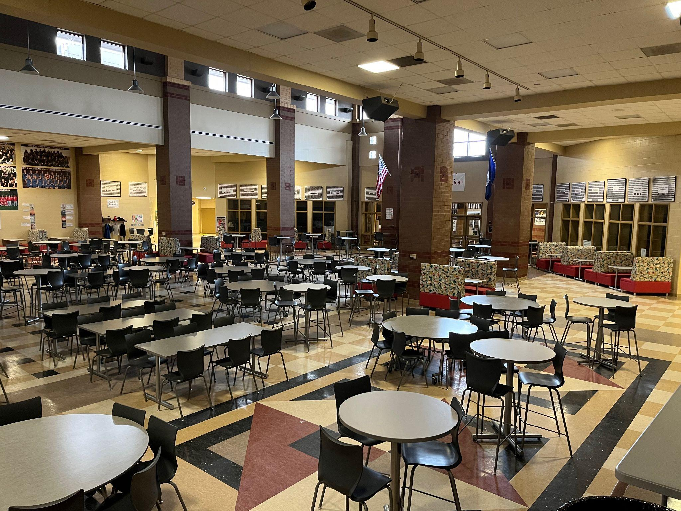
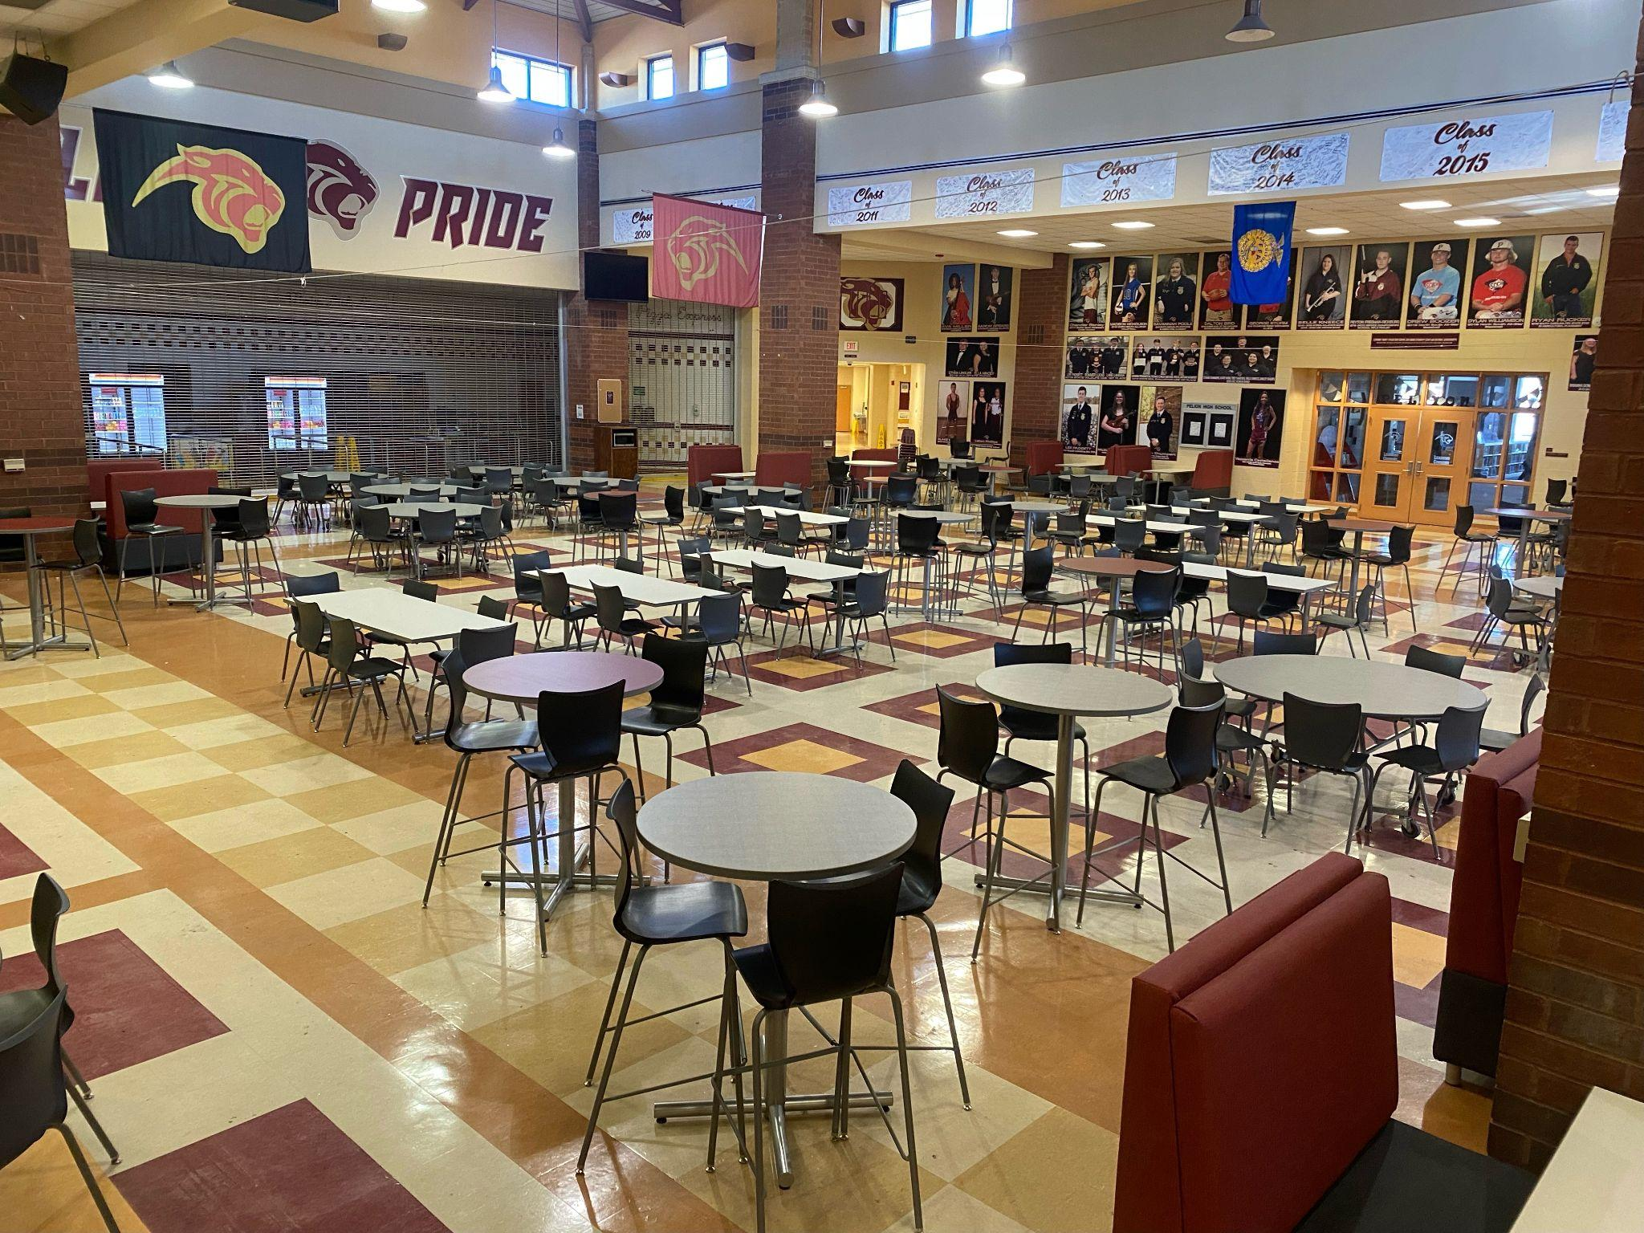
Cafeteria Furniture Replacement
GILBERT HIGH SCHOOL
PELION HIGH SCHOOL
Notes:
The cafeterias at GHS and PHS received a major upfit through this funding. New furniture at both schools has really changed the look and function of the spaces. We have received lots of positive feedback over this work and excited for the staff and students in Pelion and Gilbert.

Slide 14
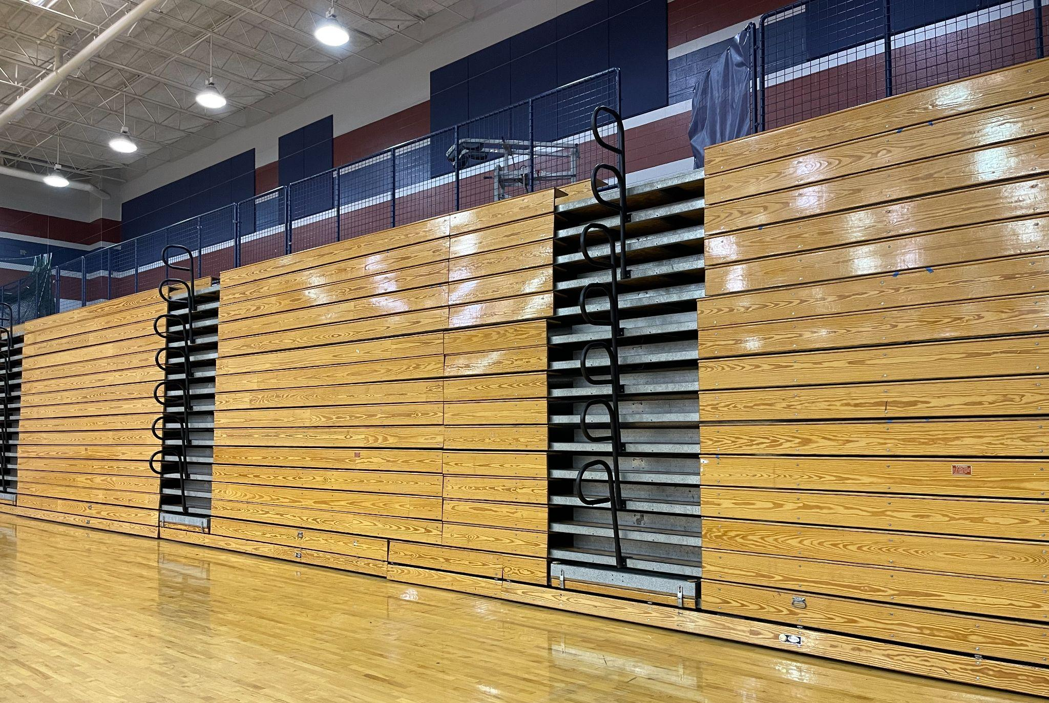
Gym Bleacher Repair
WHITE KNOLL HIGH SCHOOL
Notes:
At the WKHS competition gym we replaced row stops, system rollers and over 1500 wheels to allow for smoother bleacher movement. We are also replacing the bleacher motor at WK. Coaches and teachers pull these bleachers out and put them back often during the week and this is a need we were thankful to be able to address.

Slide 15
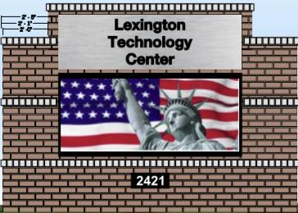
LTC Marquee Sign Replacement
Notes:
Another major project through this funding is the replacement of the marquee sign at LTC. Here is a rendering of what the sign will look like when completed. The sign is on order and we hope for an install very soon.

Slide 16
https://www.lexington1.net/Building-Plan

